Slide 1

HEIW
Coaching &
Mentoring Hub
User Guide

Slide 2

Introduction
The HEIW Coaching and Mentoring Hub, supported by PushFar, is a platform designed to help you with your coaching and/or mentoring needs, in support of progressing your career. Our platform has a wealth of tools to help you identify a suitable Coach or Mentor, manage your relationships, schedule meetings, set goals, track your progress and ultimately navigate through your coaching and mentoring experience effectively.
You are invited to register either as a Coachee or Mentee, whichever meets your development needs best. Once you’ve registered you will be requested to indicate your coaching / mentoring preferences which will support the matching process. You will be able to amend your preferences at any stage.
This guide will take you through the user process from the registration stage up to requesting a Coach/Mentor. Please note - once a request is made, it will then be processed by the Coach/Mentor from that point.

Slide 3

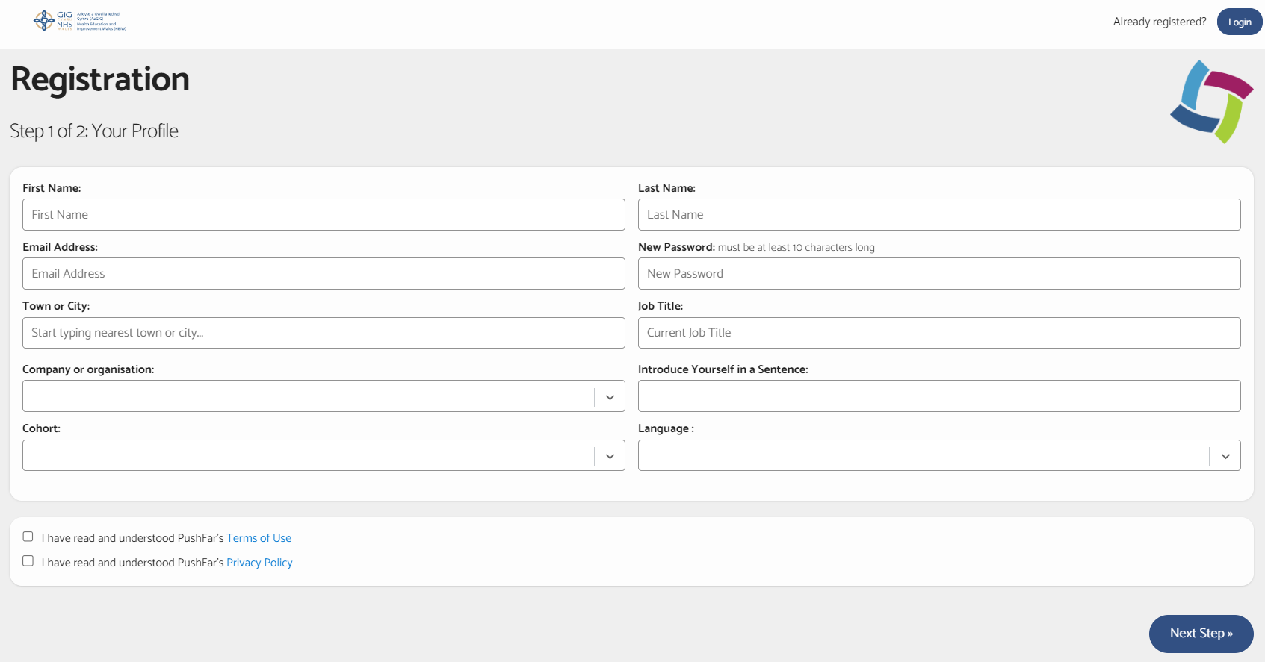
Registration and Step1
1.Follow the links below (also sent to your e-mail), for either Coaching or Mentoring, to set up your account and register your profile/ preferences.
  Find a Mentor
  Find a Coach
2.Once you are on the registration page it will take you to Step 1.
Please complete the following fields:
Name and e-mail address,
New password,
Town or city,
Job title and company/organisation,
Introduce yourself in a sentence,
Please choose NHS Wales People Profession from drop down options.
Language preference (Welsh, English or both)
3.Upload a photograph
4.Please tick the two boxes to agree to Pushfar’s terms and conditions.
5.You will then be directed to Step 3. Step 2 is not applicable and will not be visible to you.

Slide 4
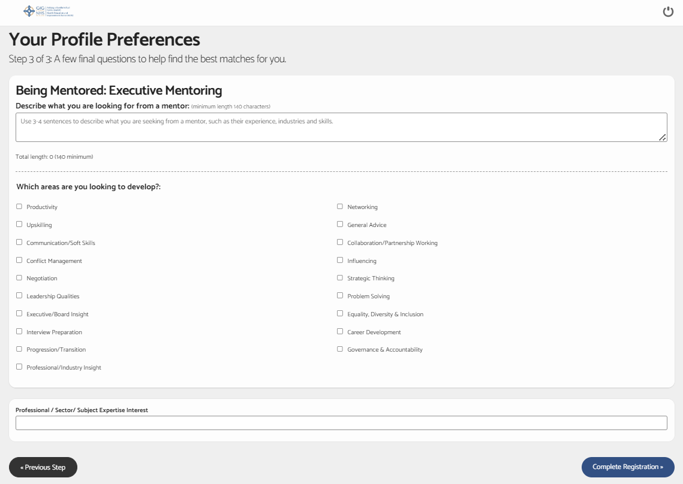
Registration – Step 3
1.Step 3 involves identifying your Coaching or Mentoring preferences. This stage will ensure that the system is able to find the best possible match for you.
2.You are asked to identify what you are looking for from a Coach or Mentor (free text).
3.You are then asked to select the areas of expertise that you would like to develop or seek support (please select all that apply). Identifying specific criteria will enable the system to match you to the most appropriate Coaches/Mentors to meet your unique needs.
4.Click ‘Complete Registration’ to upload your profile and progress.

Slide 5
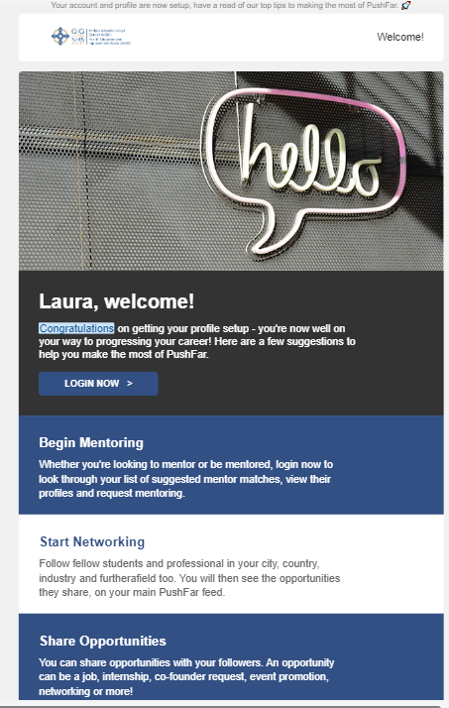
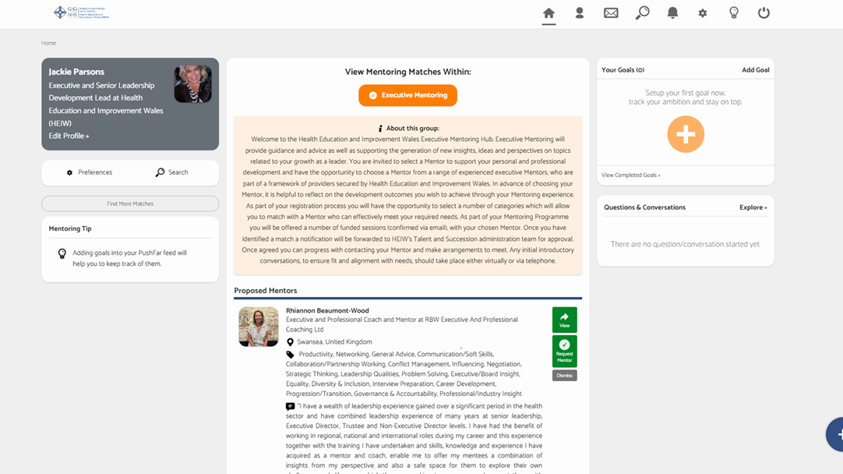
Homepage
Once you have completed registration you will be directed to your Homepage as shown below. You may need to refresh to see this view, or if you logged out you will need to log back in.
You will also receive an e-mail confirming successful registration.

Slide 6

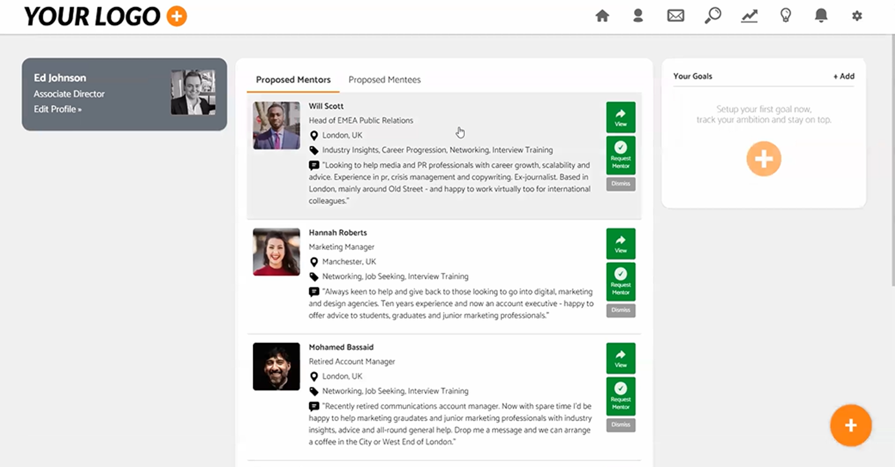
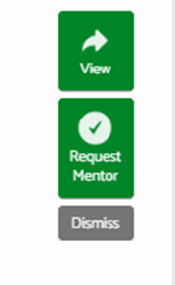

Homepage
Your homepage will automatically display a list of Coach/Mentor options selected by the platform algorithm based on information and preferences provided by you and the Coach or Mentor at registration;
They will display in order of the closest matches to your identified criteria.
The listed profiles will be in a preview format displaying a photo and limited detail.
Further profile information on the Coach/ Mentor can be accessed by selecting the green tab to the right of the profile labelled ‘View.
Scroll down to continue to browse matches - select the option ‘Show More’ to see further system matches.
To shortlist your matches or if you do not believe the match suggested is a good fit, ‘Dismiss’ to remove from your matched list.

Slide 7
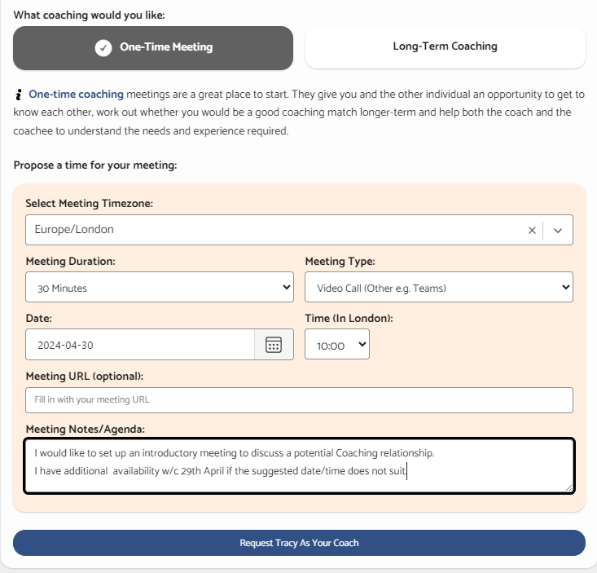
Requesting an Coaching or Mentoring Match?
1. When you receive confirmation - Log In and select the ‘Request Coach’ or ‘Request Mentor’ option (in green) next to the Coach/Mentor profile of your choice.
3.When directed to the request page choose the ‘One Time Meeting’ option in the first instance to hold a virtual, 30 minute introductory/ chemistry meeting.
4.Identify availability to meet and provide any additional information which may be helpful in the ‘Meeting Notes’ section.

Slide 8
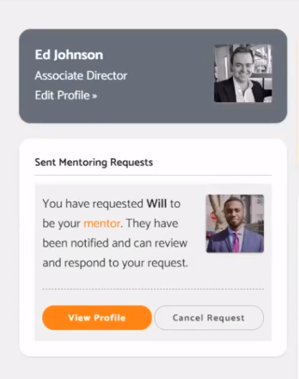
Requesting an Coaching or Mentoring Match cont.
Please note that if a Coach/Mentor is either unavailable or at capacity, the request option will not be available to select.
Once your request is submitted it will be placed into pending requests which can be found on the left-hand side of your profile
Your request will then need to be actioned by the Coach or Mentor.
It is anticipated you will request your first choice Coach or Mentor for an introductory meeting. Should this match prove to be one you do not wish to progress you can move to your second-choice match.

Slide 9
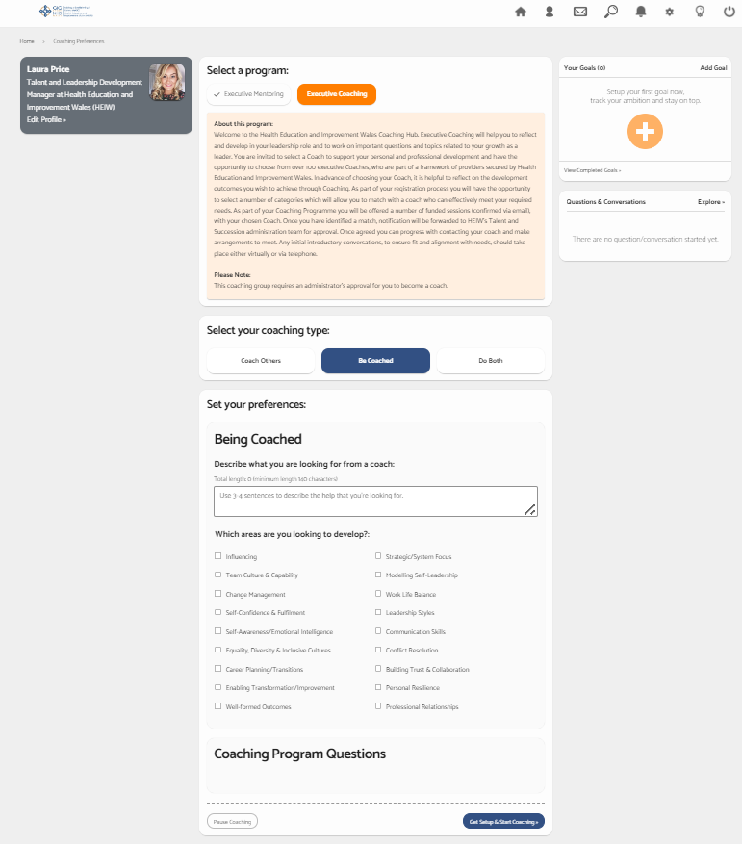
Registering to view both Coaches and Mentors
You may wish to search the Hub to view both available Coaches and Mentors; and are welcome to do so.
Please note that Coaching and Mentoring are two different groups and registration for each needs to be undertaken separately.
As Coaching and Mentoring have differing development criteria, you will be requested to set up tailored profiles / preferences for each, in order to be supplied with appropriate matches for each type of support.
Registration links are below (these have also been emailed to you).
    Find a Mentor
    Find a Coach
Notes:
The next slide will show the page you will be taken to if you access another group whilst you are still logged in.

Slide 10
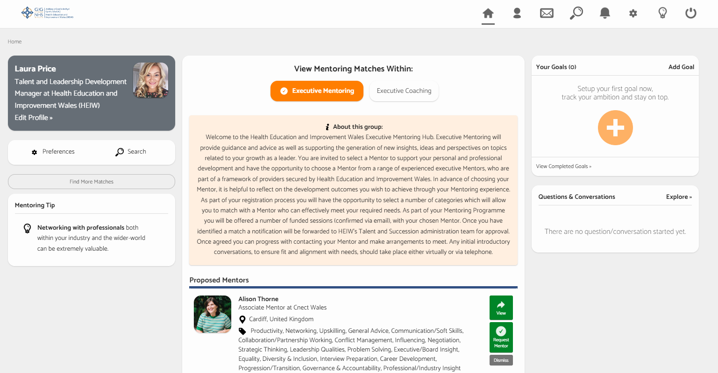
Homepage visual of Executive Coaching and Mentoring Registration
The Homepage will update once both registrations are active - please refresh or log back in if necessary.
The two groups: ‘Coaching’ and ‘Mentoring’ will now show next to each other on your account and can be selected as required.
To avoid confusion, the current selection of matches you are viewing will be highlighted in orange.
Please ensure you choose either a Coach or a Mentor from the Hub to support your development needs.
A view of the homepage once registered for both Coaching and Mentoring Groups with Mentoring selected.

Slide 11
Additional Support required?
If you require any further assistance, please contact the HEIW Talent and Succession Team via the following e-mail address:
HEIW.TalentSuccession@wales.nhs.uk
For Technical support and further information on the platform, please find the Pushfar Coaching and Mentoring Hub ‘Support’ option on the right-hand side of the webpage footer.
Notes:
Are there any screen shots which may support here?

