Slide 1



Shaping Culture and Leadership in NHS Wales​
Module 1: Compassion and Leadership
Developed with Professor Michael West

Slide 2

Module 1: Compassion and Leadership
What is Compassionate Leadership?
Alignment with own values
The Four Elements of Compassion
Why Compassionate Behaviour Matters:
The Workforce crises and evidence base
The National Resources and Tools Available to Enhance Collaboration and Sharing of Knowledge

Slide 3


1

Slide 4

Compassionate
Leadership
Personal Values
2

Slide 5


When good work or compassion is missing…
High sickness absence
High turnover
High stress levels
Leading to damaging consequences for:
Staff health
Staff performance
Quality of care
Patient Mortality rates

Slide 6
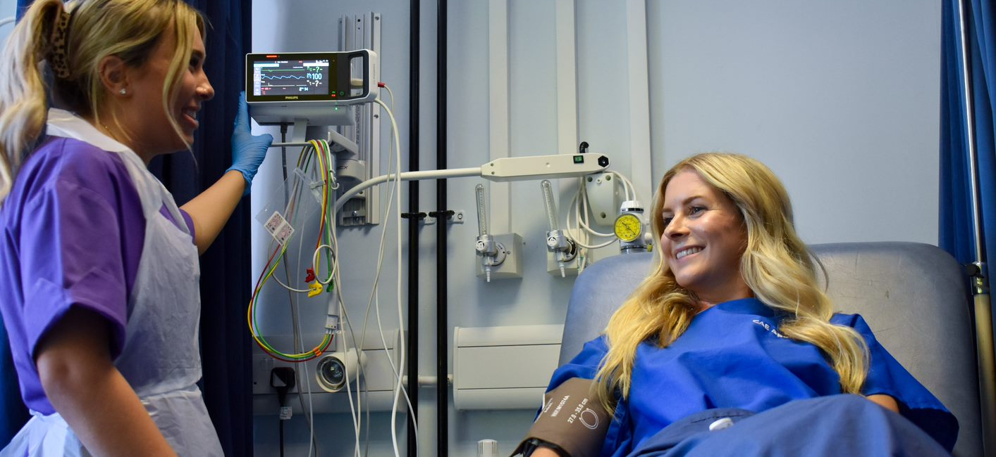
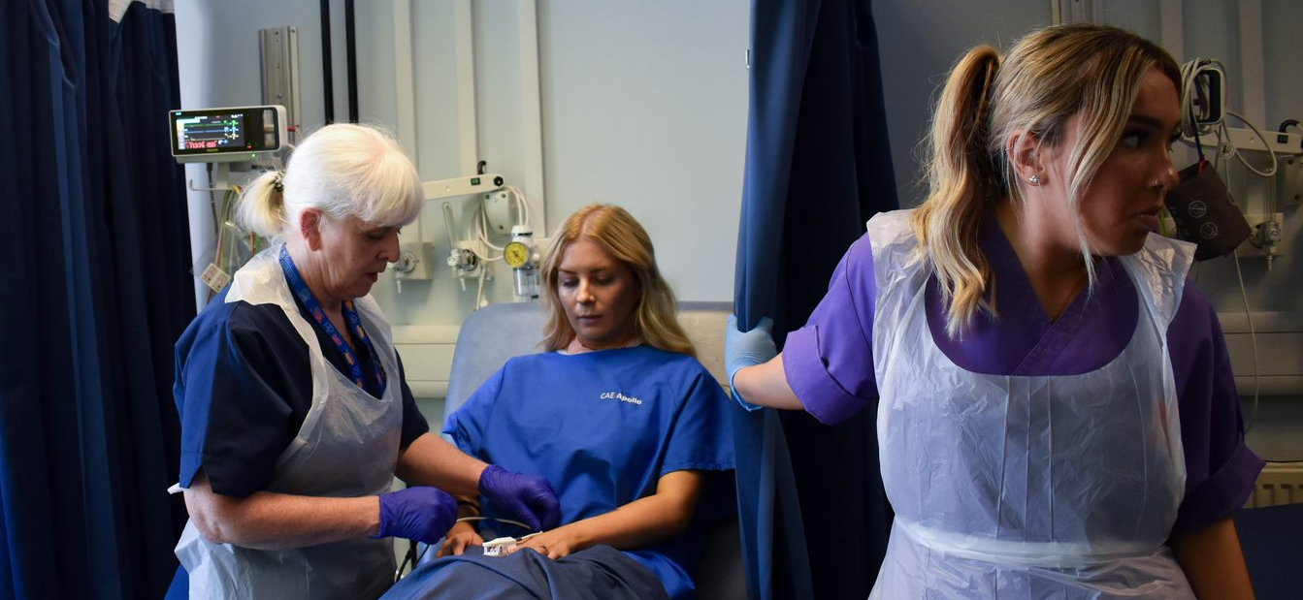
This is a great day…
or not!
3

Slide 7
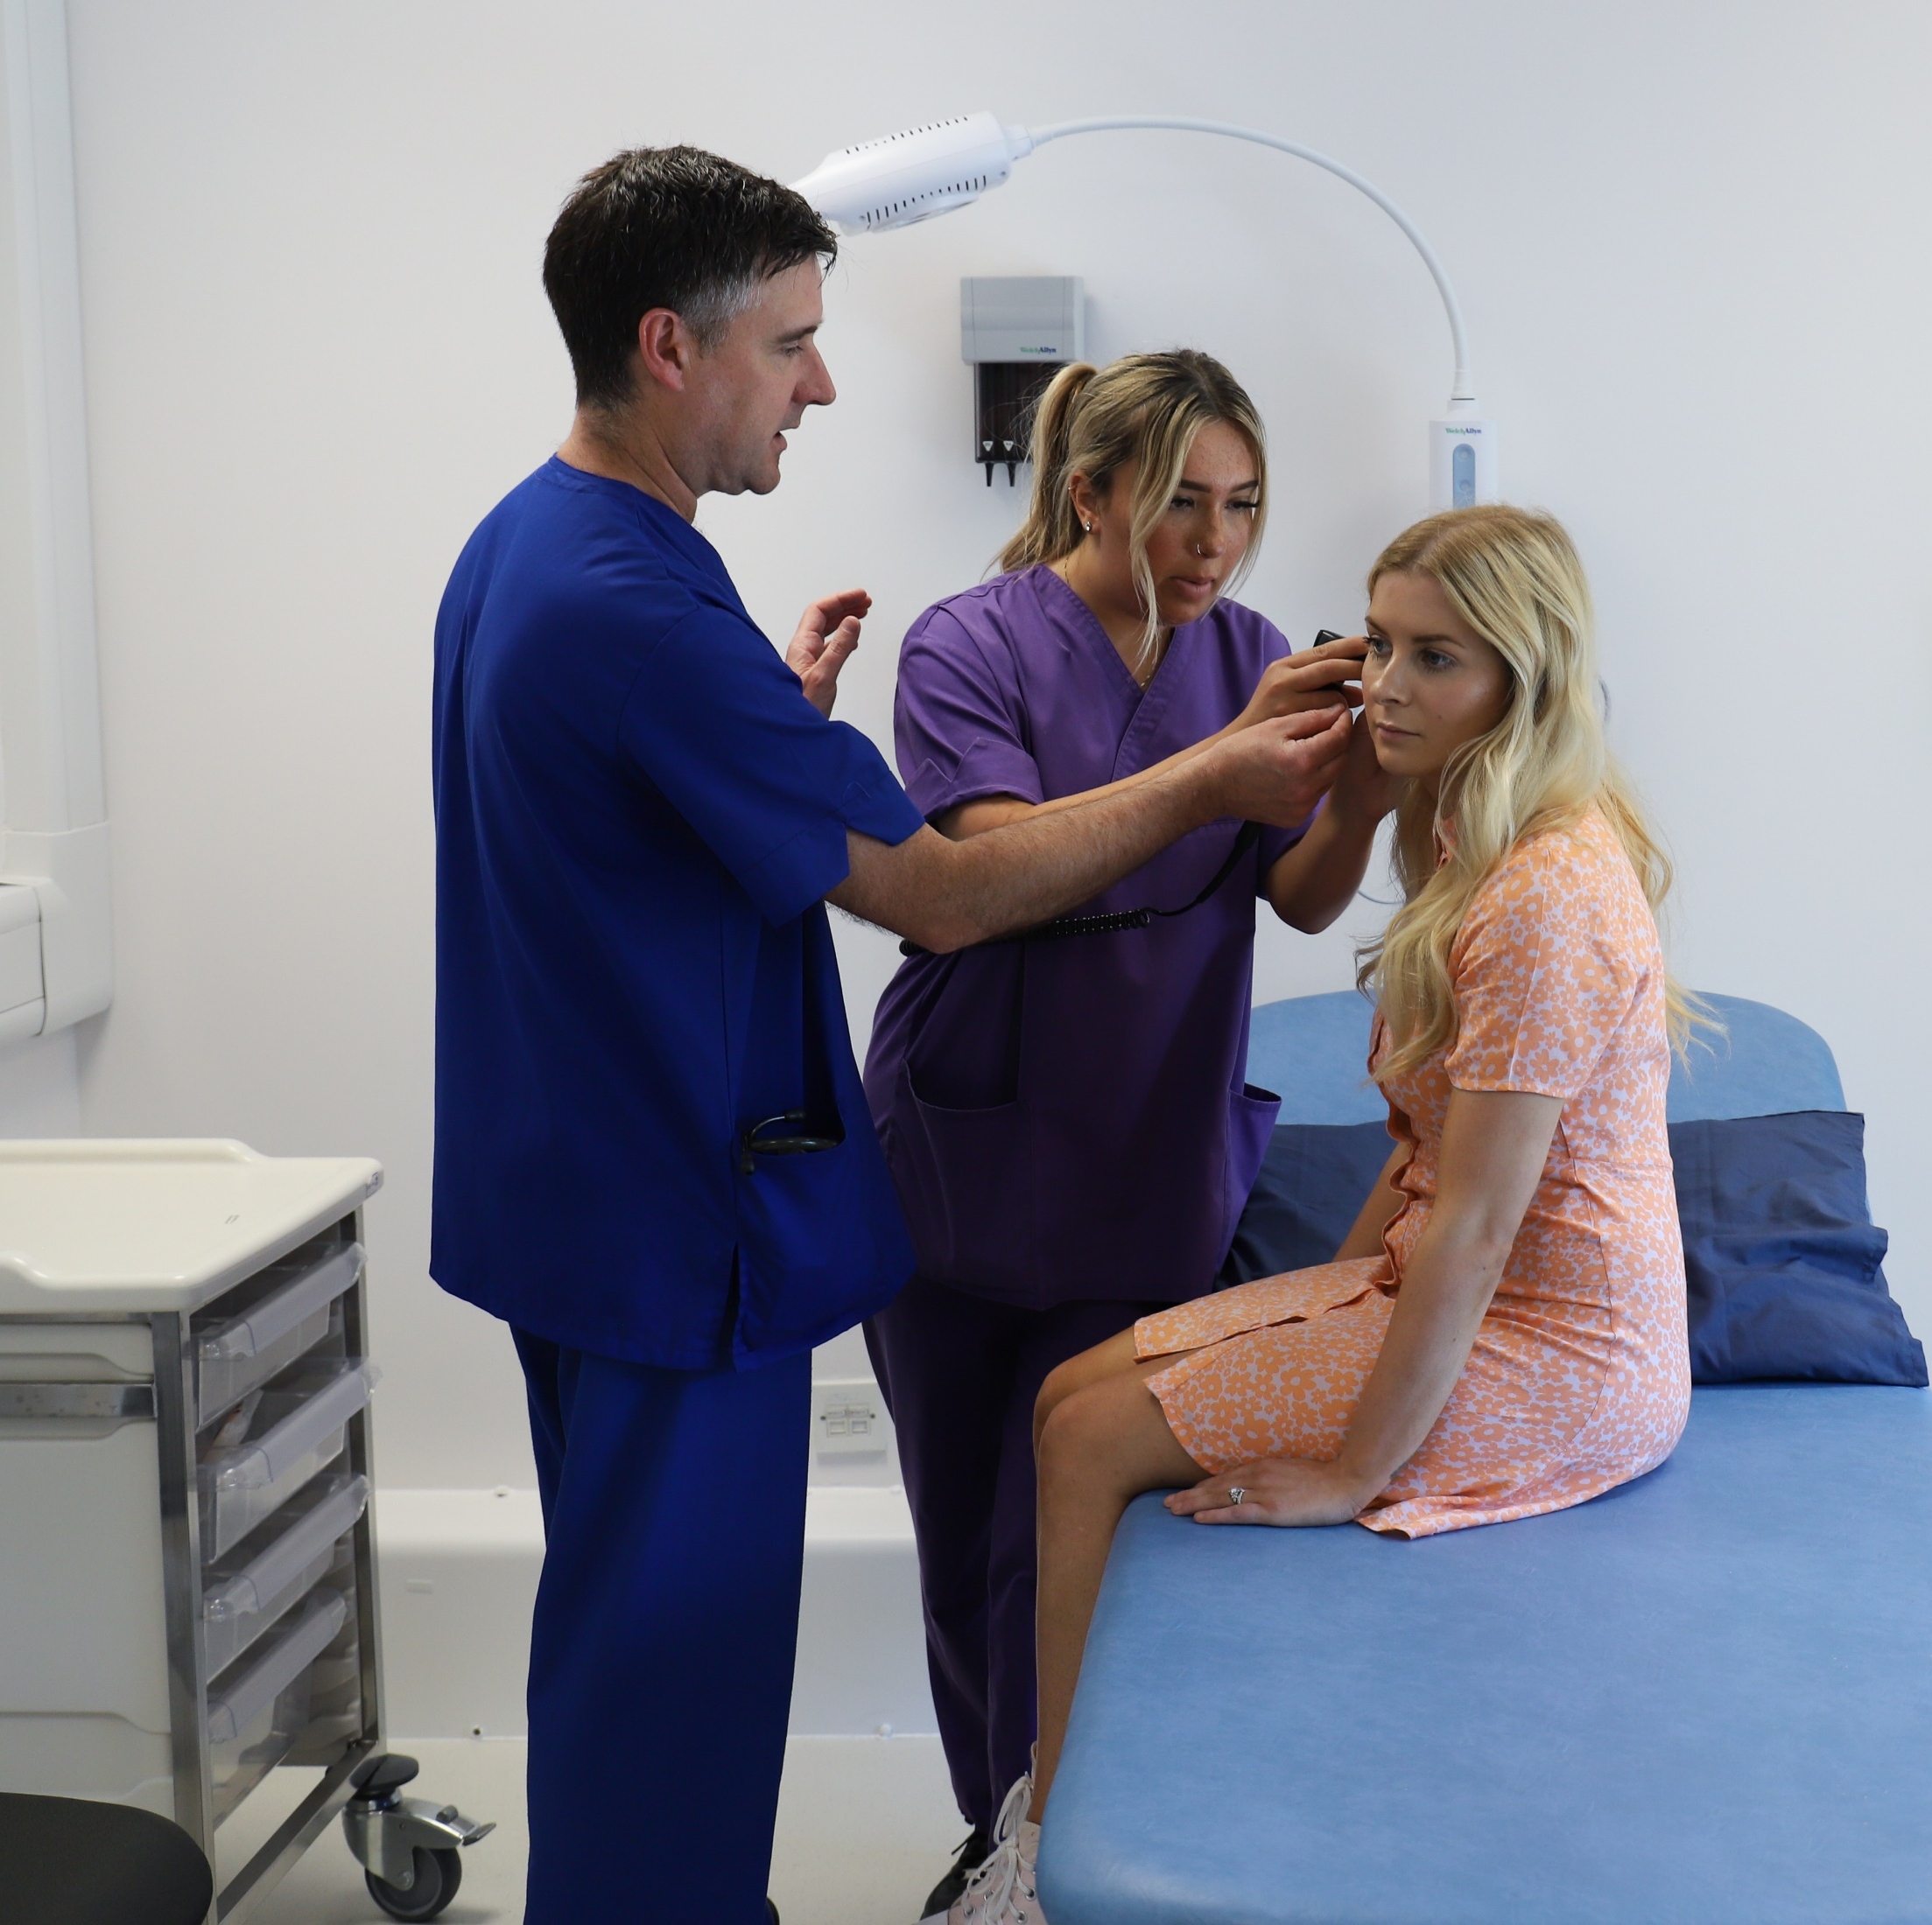
Definition of Compassion
“a sensitivity to suffering in self and others, with a commitment to try to alleviate and prevent it”
Gilbert, 2017

Slide 8

What do we mean by compassionate leadership?

Slide 9


Compassionate Behaviours Compass
Attending
Being present with those we lead. It requires that we ‘listen with attention and fascination’.
Helping
to ensure there’s a good path for those we lead
to achieve
their goals by removing the obstacles or providing the resources and support to help them deliver
high quality care.
Understanding
is dependent on listening deeply.
It requires that
we take the
time to listen
in order to
understand
the challenges
that those we
lead face in
their work.
N
Empathising
4
4
is feeling the strains, pains,
anxieties and frustrations of those
we lead without being overwhelmed by those feelings. This then gives leaders the motivation to help or serve those we lead.

Slide 10





Compassionate Leadership is…
an action, NOT a position or title or at the top of the organisation
about shared leadership; everyone is a leader – individual and team
about inclusion valuing equality and diversity, removing barriers and boundaries
about creating effective teams who feel safe and empowered to make improvements
about self compassion and promoting health and well being
Notes:
knowledge of compassionate leadership using this summary slide

Slide 11

The Crises in Health and Care
Vacancies in health care and global competition
Increasing and unsustainably high levels staff stress
Intention to quit and retention
Demands on services - Complexity, ageing population, health inequalities
Need to transform models and systems of health and care -more collective and community power. Prevention.

Slide 12
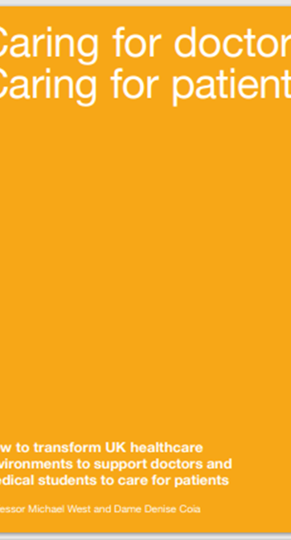
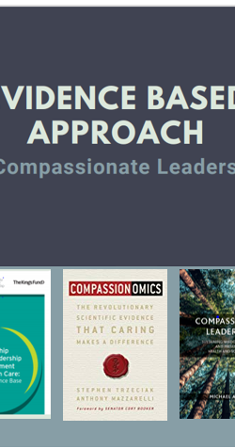

Compassion from anesthetists vs sedatives – patients calm but not drowsy. 50% lower requirement for opiates post surgery and shorter stay.
Patients randomly assigned to compassionate palliative care survived 30% longer
Diabetes – optimal blood sugar control 80% higher; 41% lower odds of complications
HIV patients 33% higher adherence to therapy and 20% lower odds detectable virus
Global Compassion Coalition
Notes:
Compassionate clinical interactions create better clinical outcomes for patients
But also importantly better conditions for staff engagement, inclusion, quality improvement, patient care, quality of services, staff retention

Slide 13

Does Compassion Matter?
Notes:
Play Video
(3) How 40 Seconds of Compassion Could Save a Life | Stephen Trzeciak | TEDxPenn – YouTube
Introduction to video from tutor:
What if healthcare providers spent an extra 40 seconds showing compassion for their patients? The scientific evidence may surprise you. Through his pioneering work in the field of “Compassionomics”, Dr. Stephen Trzeciak has found that just 40 seconds of compassion can be a powerful therapy – not only for the receiver of compassion, but for the giver, too. It changes everything. In this TEDx talk, Dr. Trzeciak takes you on a journey through the evidence that compassion matters – in both meaningful and measurable ways. Science shows that compassionate care is beneficial for health (better patient outcomes), healthcare systems and payers (lower costs), and healthcare providers (lower burnout). That’s the power of 40 seconds.
Optional/additional video for further information to supplement
What is the most pressing problem of our time - the scientific evidence that caring and compassion makes a difference .. Compassionomics
(3) The Most Pressing Problem of Our Time? | Stephan Trzeciak | TEDxUND - YouTube
This is a story of an awakening… and finding fulfilment. For physician scientist Dr. Stephen Trzeciak, his research career was going exactly as planned, and his scientific program was hitting every milestone for “success”. And then, an unexpected question from a 12 year-old (his son) caused him to reexamine his life’s work and change the trajectory of his career. One question changed everything. In this TEDxUND talk, Dr. Trzeciak will take you on a journey through this awakening, and dare you to ask the question “What is the most pressing problem of our time?” University of Notre Dame Alumnus, Class of 1992, Philosophy and Pre-Professional Studies

Slide 14
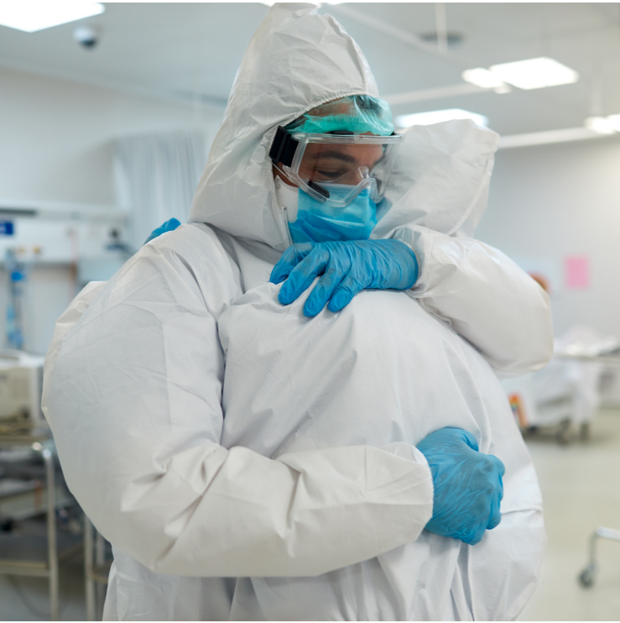
The Value Chain of
Compassionate Leadership and Outcomes
Compassionate leadership staff satisfaction, engagement
Staff engagement patient satisfaction, care quality
Poor leadership work overload, high staff stress
High work pressure less compassion for patients
High staff stress poorer care quality and finances etc.

Slide 15
What do we need to make NHS Wales a Compassionate Workplace?
4
5

Slide 16
NHS WALES COMPASSIONATE WORKPLACE
Compassionate Leadership
Compassionate Structures
Compassionate Policy & Procedures
Compassionate Systems
Compassionate Cultures
Compassionate Teams
How We Change
Culture
Quality
Safety
Notes:
we change culture and create compassionate workplaces across NHS Wales
Compassionate leadership
Compassionate Teams
Compassionate cultures
Compassionate Structures
Compassionate policy and procedures
Compassionate systems

Slide 17
Compassionate Leadership
Compassionate Teams
Compassionate Cultures
Gwella @ HEIW Evidence based resources and tools
Compassionate Leadership Programme
Advanced Clinical Leadership Programme
Leading with compassion (TKF)
Senior Leadership Experience
Mutual / Reverse mentoring
Compassionate Team Assessment
Affina OD Team Performance Inventory and Team Journey Diagnostic
Co-Lead Team tools
Commitment to Inclusion
NHS Wales staff survey
Pulse surveys
Compassionate Leadership Self Assessment & 360 Assessment
NHS Wales Core Principles
Compassionate Leadership Principles
Board Development Programme Professor M West
NHS E Culture & Leadership Programme
Compassionate Structures
Compassionate Policies and Procedures
Compassionate Systems
Compassionate Recruitment
Inclusive Talent Management
Collective Leadership
Team Based Working
Aspiring Executive Director Talent Pools
Aspiring Chief Executive Officer Programme
Workforce Strategy
Shared Leadership vision and values
NHS Wales Workforce Implementation Plan
Compassionate Wales
Design, Evaluation and impact
Strategic OD Programme
Integrated working
Commitment to Transformation
Staff Welfare Project
ABC of Core Needs
Healthy Working Relationships
Improving Employee Investigations
Systematic Workforce Policy Review
Notes:
slide provides the detail

Slide 18

Exercise
6

Slide 19

Compassionate Leadership Principles
These overarching principles underpin our ambition that by 2030, leaders in the health and social care system will display collective and compassionate leadership
As Compassionate Leaders across Health and Social Care in Wales we will...
Improve equality, inclusion and diversity, consciously removing barriers and boundaries
Develop supportive and effective team and inter-team working
Agree direction and ensure alignment and commitment
Enable safe, respectful trusting and engaging systems and cultures
Manage difficulties positively, openly, courageously and ethically
Create environments where collective leadership thrives
Establish the conditions people to reflect, learn, continually improve and innovate

Slide 20
What is Self-Compassion?
Through self-compassion we become an inner ally instead of an inner enemy
(Drs Neff & Germer)
Self-Kindness
Mindfulness
Common Humanity
7
Notes:
Self-compassion involves treating yourself the way you would a friend who is having a hard time, Western culture places great emphasis on being kind to our friends, families and neighbours who are struggling. Not so when it comes to ourselves. Self-compassion is a practice in which we learn to be a good friend to ourselves, when we need it most – to become an inner ally rather than an inner enemy.
Self Kindness – When we make a mistake or fail in some way, we are more likely to beat ourselves up than put a supportive arm around our own shoulder. Self kindness counters this tendency so that we are as caring towards ourselves as we are towards others. This about your car journey home, you will dwell on what went wrong that day more than celebrate what went well.
Instead of attacking and berating ourselves for being inadequate, we should offer ourselves warmth and unconditional acceptance.
Common Humanity - It’s recognising that all humans are flawed works in progress, that everyone fails, makes mistakes, and experiences hardships in life. This is completely normal and natural. However, we fall into the trap of believing that things are supposed to go well all the time, and that something has gone wrong when they don’t. Making mistakes is normal and natural, But we don’t tend to be rational about these matters instead we suffer and feel isolated alone in our suffering
Mindfulness – Involves being aware of moment-to-moment experience in a clear and balanced manner. It means being open to the reality of the present moment, allowing all thoughts, emotions and sensations to enter awareness without resistance and avoidance Being able to tum toward and acknowledge when we are suffering and to ‘be’ with our pain long enough to respond with care and kindness. Mindfulness counter the tendency to avoid painful thoughts and emotions, allowing us to face the truth of our experience , even when its unpleasant. At the same time, mindfulness prevents us from absorbed with negative thought or getting caught up by our adverse reactions .. Not only did I fail .. I am a failure. When we mindfully observe our pain we can acknowledge our suffering without exaggerating it, allowing us to take a wiser and more objective on ourselves and our lives.

Slide 21
Being a Compassionate Leader
Requires Self Compassion
Ask yourself:
Am I attending to myself – being present in the moment?
Do I understand the challenges I face? Understanding your preferences, your approach to situations? How you like to approach tasks as well as work-life balance challenges?
Am I caring for myself? Prioritising self care, affirming sense of self?
Am I helping and supporting myself, knowing where and when to get support – acknowledging that self care and self compassion is important
7

Slide 22
Strategic System Retention Drivers
Improved Retention
Compassionate Leadership
Compassionate Systems
Compassionate Cultures
Quality
Safety
Compassionate Policies
Compassionate Teams
Compassionate Structures
Notes:
Reminder of Strategic Context
Whole system approach – embodied by the Workforce strategy for health and car in Wales – Compassionate and collective leadership was the strategy adopted based on significant evidence base and other nations approach
Compassionate structures – Talent & Succession Planning
Compassionate policies – Healthier working relationships; Improving employee investigations
Compassionate Systems – Workforce planning - designing systems organisations and processes that prioritise empathy, understanding, wellbeing, collaboration and inclusion.
Data analytics, Staff survey = ambition of creating a compassionate public sector Wales

Slide 23
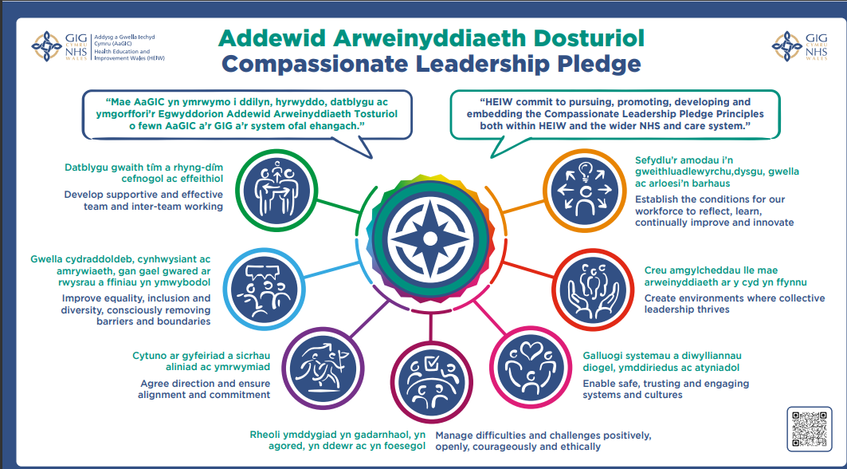
Notes:
Consider adopting the Compassionate Leadership Pledge at organisation level or team level

Slide 24
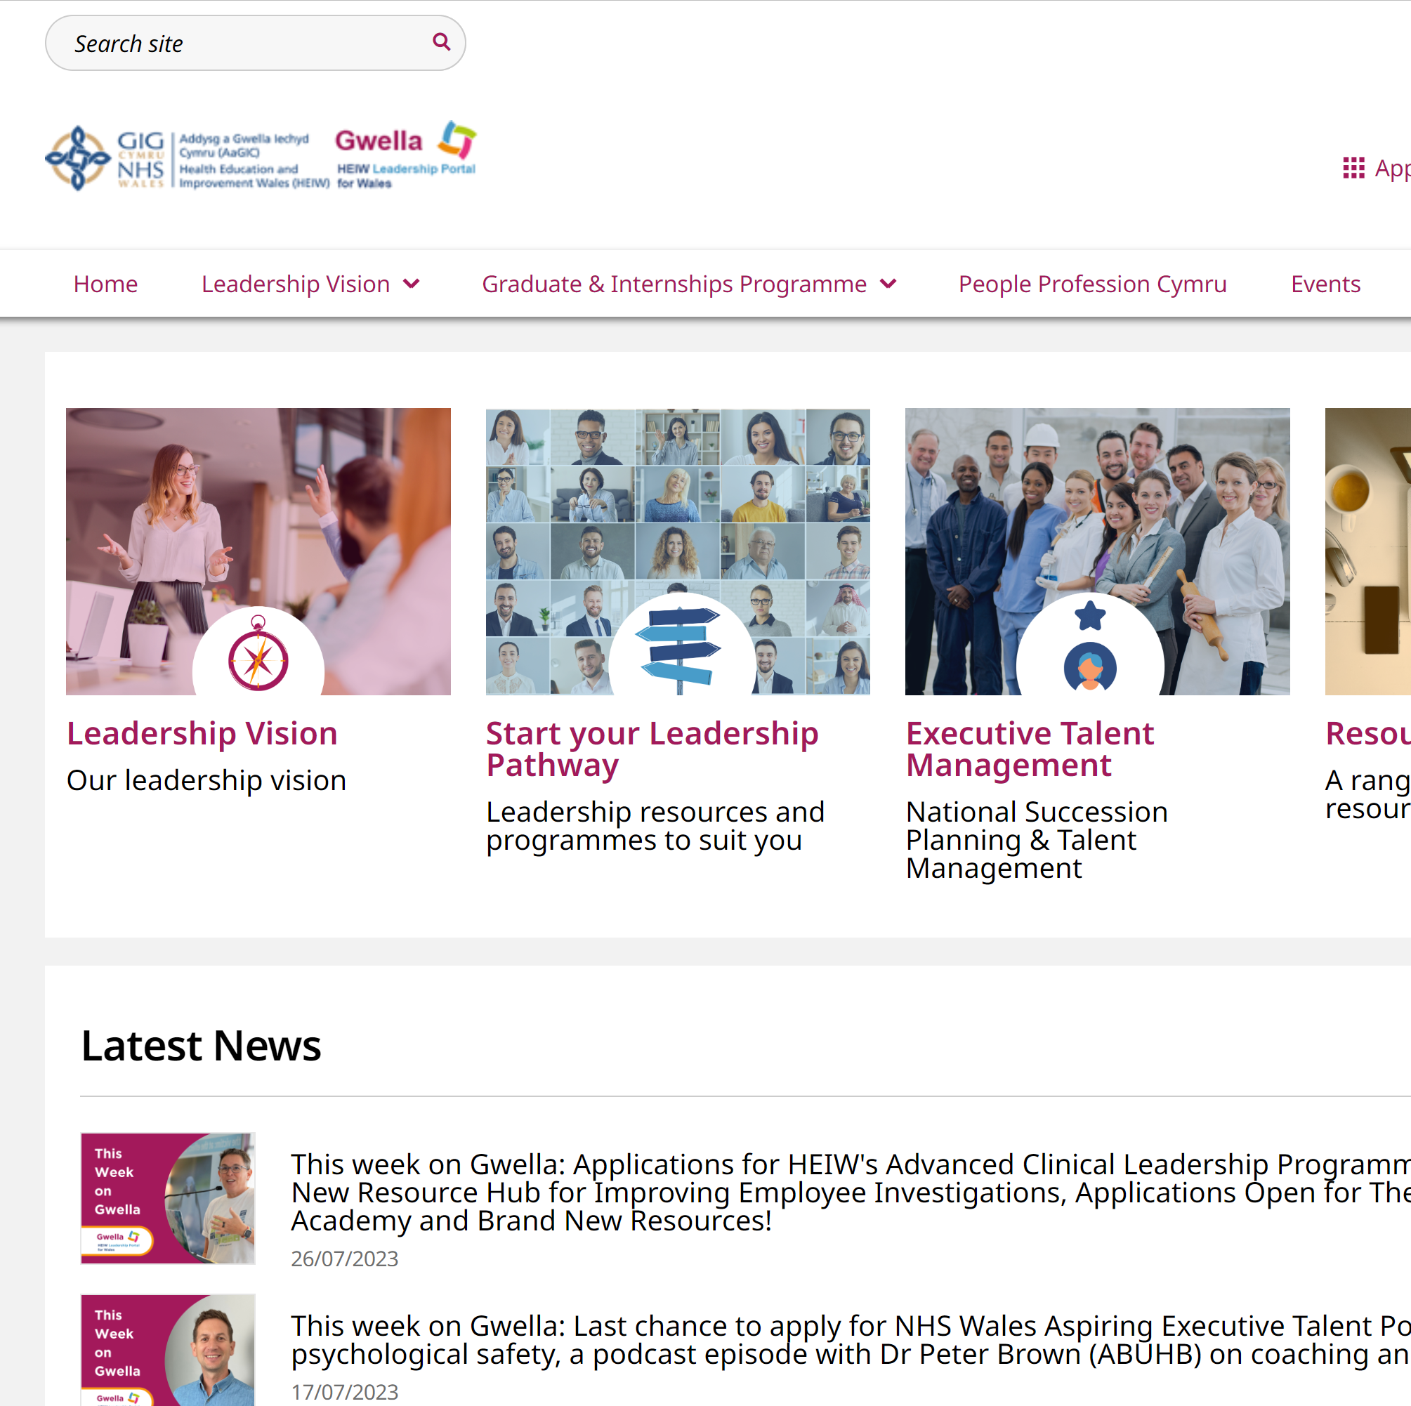

More resources…

Slide 25
Reflections and next Steps
What has struck a chord with you today?
What action will you take back in the workplace?
What further support do you require?

