Slide 1



Shaping Culture and Leadership in NHS Wales​
Module 3: Compassionate Leadership is Effective, Inclusive and Collective
Developed with Professor Michael West
Notes:
Introductions and exploration of participant aims and objectives – what do participants want to get out of this session
Encourage questions, debate, and challenge. Be inclusive.

Slide 2

Module 3: Compassionate Leadership is Effective, Inclusive and Collective
Compassionate leadership creates Direction, Alignment and Commitment
Develop skills for ensuring compassionate leadership is collective leadership
How compassion, inclusion and valuing diversity can be integrated and applied
The national resources and tools available to support in the delivery of effective, inclusive and collective leadership
Notes:
Outline the aims for the module :
To ensure compassionate leadership creates direction, alignment and commitment
To demonstrate how compassion, inclusion and valuing diversity can be integrated and applied
To develop skills for ensuring compassionate leadership is collective leadership

Slide 3
Compassionate leadership is effective, inclusive, collective and systemic
Effective
Leadership
Inclusive
Leadership
Collective Leadership
Systems
Leadership
Attending
Direction: A clear shared inspiring purpose or vision
Alignment: clear goals for people and teams, aligned and springing from the vision
Commitment: Developing trust and motivation
Clear, shared inspiring purpose or vision
Positively valuing difference
Frequent face to face contact
Continuous commitment to equality and inclusion
Clear roles and strong team
Everyone has leadership responsibility
Shared leadership in teams
Interdependent leadership across boundaries
Consistent leadership styles across the organisation
Shared vision and values
Long term objectives
Frequent face to face contact
Constructive and ethical conflict management
Mutual support and altruism across boundaries
N
Understanding
Empathising
Helping
Notes:
Compassionate leadership subsumes effective, inclusive and collective leadership. This is taken from page 3 of the Leadership Principles for Health and care in Wales. Compassionate leadership involves ensuring that the health and social care team or organisation is delivering high-quality and compassionate care for the people and communities it serves. Such leadership must therefore be effective, inclusive, collective and systemic (working across boundaries)

Slide 4
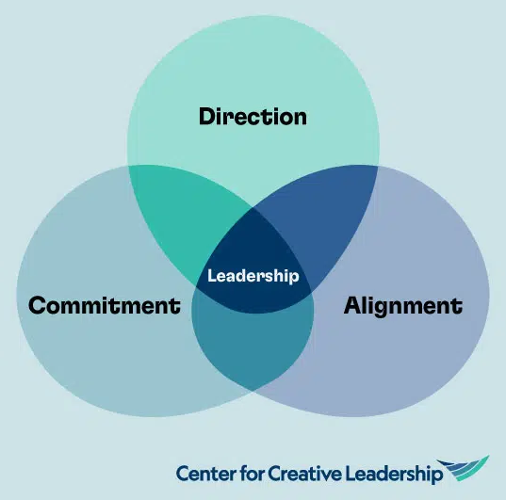
Effective Compassionate Leadership creates DAC:
Direction: A clear, shared, inspiring vision and 4- 6 clear, agreed, challenging goals
Alignment: The efforts of people and teams aligned and springing from the vision
Commitment: Developing trust and motivation
Notes:
Compassionate leadership subsumes effective, inclusive and collective leadership. This is taken from page 3 of the Leadership Principles for Health and care in Wales. Compassionate leadership involves ensuring that the health and social care team or organisation is delivering high-quality and compassionate care for the people and communities it serves. Such leadership must therefore be effective, inclusive, collective and systemic (working across boundaries)

Slide 5



Exercise
Individually complete the brief questionnaire from the Center for Creative Leadership on assessing DAC in teams
1
Notes:
Exercise 1 (part 1) - Individual and then group work (Exercise sheet 1)
Individually complete the brief questionnaire from the Center for Creative Leadership on assessing DAC in teams (available on resource worksheet or can be accessed online via QR code on screen)
Direction, Alignment, and Commitment Assessment | CCL

Slide 6
Exercise
“What can you, as compassionate leaders do, to ensure direction, alignment and commitment?”
1
Notes:
Exercise 1 (part 2) - Individual and then group work (Exercise sheet 1)
Reflecting on the scores from the questionnaire….
2. What can they, as compassionate leaders do, to ensure direction, alignment and commitment?
3. Work individually and then discuss in small groups - summarise key themes for feedback in plenary noting / summarising key themes emerging

Slide 7

Direction
A clear, shared, inspiring vision and four to six clear, agreed, challenging goals
Where direction is not clear:
There is disagreement on priorities
People feel pulled in different directions
People feel they are not making sufficient progress – just going in circles
Notes:
Following feedback from Exercise, run through the next few slides highlighting what is looks like when DAC is and isn’t present.
Do any of these descriptions resonate with participants?

Slide 8

Direction
A clear, shared, inspiring vision and four to six clear, agreed, challenging goals
Where direction is clear:
There is a clear vision and set of overarching organisational goals that everyone is committed to
People say why those goals are worthwhile and with conviction
There is strong agreement on what success will look like.
Notes:
Leaders relentlessly focused on an inspirational vision and values

Slide 9

Alignment
The efforts of people and teams aligned and springing from the vision
Where direction is not clear:
There is disarray, deadlines are missed and there is duplication
People are unclear, overworked and frustrated
People feel isolated from one another
Teams compete rather than collaborate.

Slide 10

Alignment
The efforts of people and teams aligned and springing from the vision
Where direction is clear:
People are clear about each other’s roles and responsibilities (and their own)
People and teams integrate their work effectively to achieve success
There is strong coordination and synchronising of effort

Slide 11

Commitment
Developing trust and motivation
Where commitment is not clear:
Important tasks are not done, and easy work is prioritised
People are not mutually supportive
People do not express faith in their immediate or senior leaders
There is cynicism and passivity

Slide 12

Commitment
Developing trust and motivation
Where commitment is clear:
People are more likely to put their hearts into delivering high-quality care
There is a strong sense of trust and shared responsibility for the work
People are positive, passionate and motivated about their work
People support each other to cope effectively
Notes:
Commitment is achieved when leadership enhances rather than undermines staff trust and motivation. Compassionate leadership fundamentally embodies a supportive people management approach.

Slide 13

Recognising Direction, Alignment & Commitment
 | Happening | Not Happening
Direction | There is a vision, a desired future, or a set of goals that everyone buys into. Members of the collective easily articulate how what they are trying to achieve together is worthwhile People agree on what collective success looks like. | There is lack of agreement on priorities People feel as if they are being pulled in different directions. There’s inertia; people seem to be running in circles
Alignment | Everyone is clear about each other’s roles and responsibilities The work of each individual/group fits well with the work of other individuals/groups. There’s a sense of organisation, coordination, and synchronisation | Things are in disarray: deadlines are missed, rework is required, there’s duplication of effort People feel isolated from one another Groups compete with one another
Commitment | People give the extra effort needed for the group to succeed There’s a sense of trust and mutual responsibility for the work People express considerable passion and motivation for the work | Only the easy things get done Everyone is just asking “what’s in it for me?” People are not “walking the talk”
Notes:
The above Figure from the Center for Creative Leadership Summarises how to recognise when DAC is and isn’t happening

Slide 14

Why should we be inclusive?
If leadership is not inclusive, it is not compassionate
Notes:
Introduce inclusive leadership as the next topic.

Slide 15
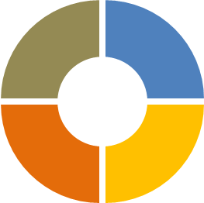

Why should we be inclusive?
Compassionate Behaviours Compass
Attending
Being present with those we lead. It requires that we ‘listen with attention and fascination’.
Moral Issue
Health Inequalities
Positively diverse teams and organisations are more productive and innovate
Better care quality and financial performance
Four behaviours of Compassionate Leadership is core to inclusive leadership
Helping
to ensure there’s a good path for those we lead
to achieve
their goals by removing the obstacles or providing the resources and support to help them deliver
high quality care.
Understanding
is dependent on listening deeply.
It requires that
we take the
time to listen
in order to
understand
the challenges
that those we
lead face in
their work.
N
Empathising
is feeling the strains, pains,
anxieties and frustrations of those
we lead without being overwhelmed by those feelings. This then gives leaders the motivation to help or serve those we lead.
Notes:
Why should we be inclusive?
Moral issue – it’s the right thing to do
The welfare state (including the NHS) was founded on the principle of providing free, high-quality care to all who needed it regardless of (for example) wealth, status, skin colour, ethnicity, prestige or socio-economic background. The core founding values of the NHS were (and remain) therefore compassion and inclusion
Positively inclusive teams and organisations are more productive and innovative than those which are less inclusive. Why? Because they utilise much more fully the knowledge, skills, motivation and experience of all who work within them. Moreover, the outcomes are greater than simply the sum of the parts because the synergies that emerge from capitalising on and combining everyone’s contributions generate creativity, innovation, commitment and smart decision making that enable us to deal effectively with the challenges we face.
If leadership is not inclusive of all in the organisation, it is not compassionate. Compassion involves attending to every individual, understanding each person’s challenges, empathising with every individual, and having the motivation to act to help each and every person to whom we offer leadership. Compassion means being present for all and helping all those we lead.

Slide 16
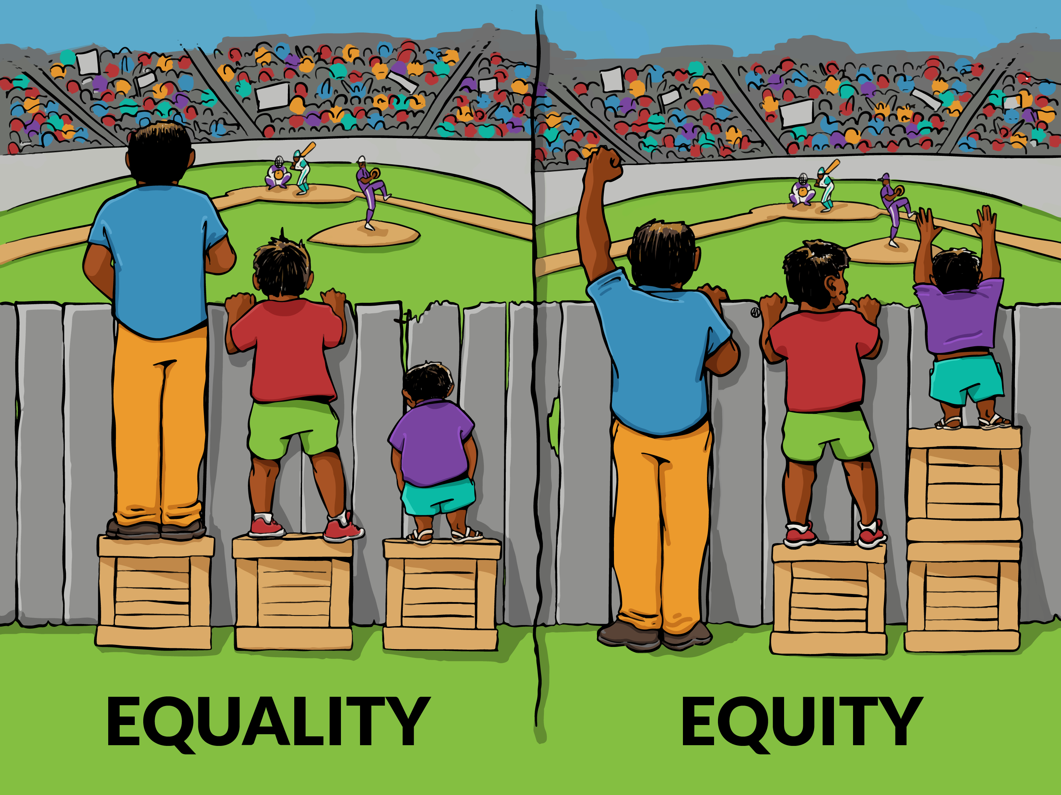
Promoting
equity and
equality
Notes:
Explore inclusive leadership: Promoting equity and equality
Inclusive leadership is all leaders focused on ensuring equity, positively valuing diversity and ensuring all they lead are included. It is important to understand the implications of these three leadership concepts, beginning with leading to ensure equity.
The figure illustrates why equality does not mean the same as equity. Although both promote fairness, equality achieves this through treating everyone the same regardless of need, while equity achieves this through treating people differently according to need.
Compassionate leadership requires us to attend to each person by being present with them and ‘listening with fascination’. It also requires we seek to understand the challenges they face which may spring from their gender, nationality, ethnicity, (dis)ability, socioeconomic background, professional grouping, sexuality, health conditions or neurodiversity.
Seeking to understand these challenges is not a virtue signalling process – wanting to appear understanding to communicate how virtuous we are. Rather it must reflect a genuine curiosity about the challenges those we lead face. Being inquisitive about differences and challenges is helpful because it enables us to be more empathic or caring.
By understanding the challenges, we can more easily imagine how it would be to face such challenges and experience the emotions that go with those challenges. This then gives us the motivation to help by taking the steps that will help to create equity – ensuring fairness by treating people differently according to their needs. The four elements of compassionate leadership provide the means by which we can deal with the issues of equity and fairness effectively.

Slide 17

Valuing Diversity
Compassionate leadership is seeing diversity as a positive in all its forms
Diverse teams with positive climates and clear goals are more productive and innovative than other teams
Compassionate leadership requires ‘listening with fascination’ to and valuing the diverse contributions of team members
Being equally present with and supporting all team members
Notes:
Explore Inclusive Leadership: Valuing Diversity
Compassionate leadership is underpinned by a core value, modelled in leadership, of seeing diversity as a positive in all its forms – including professional background, age, religion, gender, nationality, (dis)ability, socioeconomic background, ethnicity, sexuality, and neurodiversity.
The research evidence shows diverse teams that have positive climates, clear objectives, good communication and in which diversity is valued are more productive and innovative than less diverse teams (whether on the frontline or at board level
Team diversity is associated with better quality team decision making. The integration of diverse perspectives creates the potential for combinations of ideas from different domains and better decision making in the interests of patients and service users.
Compassionate leadership behaviours include paying attention to diversity in the team – being aware of the multiple dimensions of diversity and valuing those differences between team members. It requires ‘listening with fascination’ to the diverse contributions and experiences of team members which, in turn, communicates a valuing of that diversity.
Teams that attend to, understand and value diverse perspectives find it relatively easy to implement new ideas and quality improvement. The richness of the information they have available and make use of enables them to undertake a more comprehensive and detailed analysis of problems they face.

Slide 18

Modelling inclusive leadership
Compassionate leadership requires courage and that includes the courage to practise self-awareness in the moment and to identify how our relationships differ among those we lead and interact with.
M West (2021)
Notes:
Discuss how participants can model Inclusive Leadership
Compassionate leadership is the means by which we ensure inclusive leadership. In practice this means everyone in the team feeling included by the leadership, rather than excluded. Compassionate leaders will be rated as inclusive by all those in their teams.
Compassionate leadership involves attending to every person we lead; understanding their challenges; empathising with them; and helping them.
Research has shown that leaders spend more time with those they see as like them. They also see those they feel more like, or more similar to and comfortable with, as more competent than those they see as dissimilar
Compassionate leadership involves working harder to understand, empathise and help all of those we lead rather than just those we are most comfortable with.

Slide 19
Compassionately Managing Conflict
Compassionate leadership involves moving towards rather than away from conflict.
Four types of Conflict at work:
Task - conflict over what the task is, the objectives or goal
Process - disagreement about how to undertake the task or how we achieve the goal
Status - disagreement about who has authority or who is in charge
Interpersonal conflict - personal feelings result in resentments, desire to hurt or punish and feelings of anger
Notes:
Compassionately Managing Conflict – Diversity creates the potential for conflict as much as creativity
Explore Constructive controversy versus conflict: Exploration of opposing opinions; Open-minded consideration and understanding; Concern for integration of ideas; Concern with high-quality solutions; Valuing diversity.
Diversity demands extra efforts at integration since diversity creates the potential for conflict as much as for creativity. Such divergence often causes conflict which is why diversity can often lead to conflict in the workplace and society generally. But research evidence clearly shows that if a team’s diverse knowledge and experience can be harvested, the team will have a greater wealth of knowledge and experience to draw upon.
Amy Gallo distinguishes between four types of conflict at work: task, process, status and interpersonal conflict. Any of the first three conflicts can easily develop into relationship conflict if they are not addressed and resolved.
Chronic interpersonal conflicts are profoundly damaging to team performance, so compassionate leadership involves engaging with those involved in such conflicts by ‘listening with fascination’, achieving a shared understanding, empathising and helping. Those people in conflict also need to listen to each other with fascination, arriving at a shared understanding, empathising with each other, and committing to helping each other. The courage of compassionate leadership is also to make clear that team members cannot be permitted to allow interpersonal conflicts or dislikes to become chronic.
Conflicts over task related issues – such as how best to meet work demands, improve quality or support team members – are an inevitable consequence of team decision-making in a context of seeking to continually improve performance. Compassionate leadership provides a safer context for the management of conflict. Link back to DAC, ensuring Direction, Alignment and Commitment.
Compassionate leaders must encourage: cooperative team climates, commitment to shared team goals, team members confirm each other’s personal competence and show appreciation, and team members are supportive in the way they seek to mutually influence each other.

Slide 20
Exercise
Identify the ways that you, as a
compassionate leader, can better ensure:
Your leadership is inclusive
Equity and Equality
You and your team values diversity in all its forms
Conflict is managed more effectively within your team
2
Notes:
Exercise 2 - Individual and the in pairs (Exercise sheet 2)
Work individually to identify ways participants as compassionate leaders can better ensure:
Their leadership is inclusive
Equity and equality
They and their teams value diversity in all its forms
Manage conflict more effectively within their teams
Then share in pairs and write four or five key goals (Clear and challenging) for themselves to strengthen their inclusive leadership over the next 12 months.

Slide 21

Why Collective Leadership?
Compassionate Leadership is Collective Leadership
Collective leadership involves:
enabling all to lead
shared team leadership
leaders working together across boundaries
leaders working with communities
consistent leadership styles and values.
Notes:
Introduce the final topic of the module – Collective leadership
In compassionate and collective leadership cultures, responsibility and accountability function simultaneously at both individual and collective levels. They breed regular reflective practice focused on failure, exploratory learning and making continuous improvement an organisational habit. By contrast, command-and-control leadership cultures invite the displacement of responsibility and accountability onto single individuals, which can lead to scapegoating and climates of fear of failure, rather than an appetite for innovation.

Slide 22
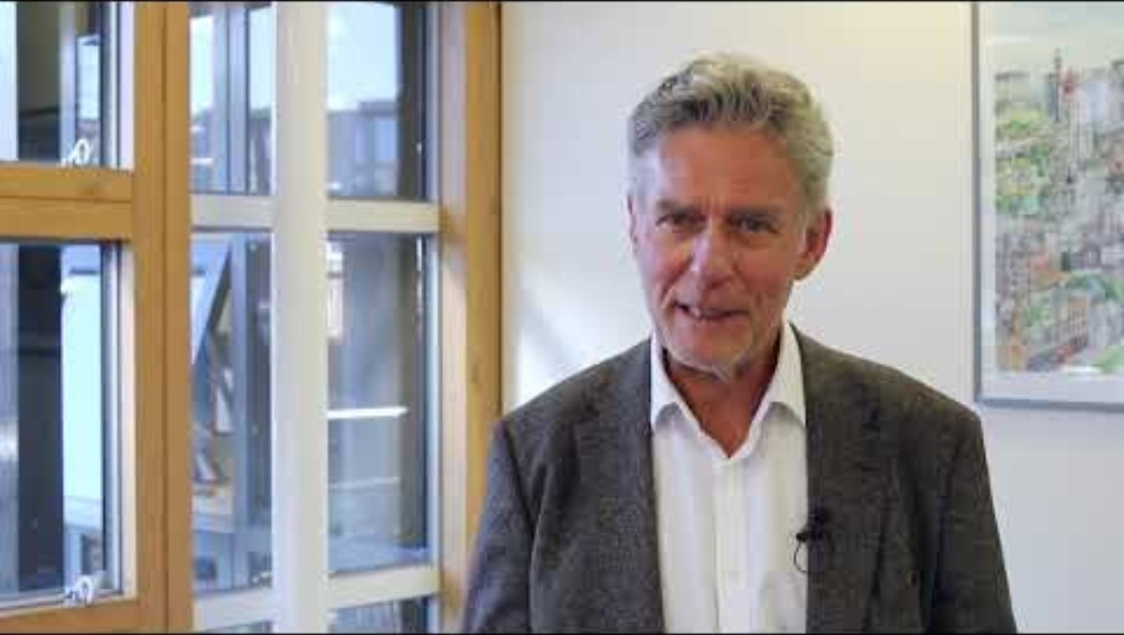
Notes:
Introduce this video from Michael West discussing inclusive and collective leadership. Ask for reflections.
Go to Gwella resource page - Gwella HEIW Leadership Portal for Wales
Enter Collective and Inclusive Leadership Repository - Gwella HEIW Leadership Portal for Wales
Play Michael West: Compassionate and inclusive leadership up until 3mins 20secs Repository - Gwella HEIW Leadership Portal for Wales

Slide 23

Collective leadership
Personalised versus socialised power
Compassionate leadership is the opposite of personalised power. Compassionate leadership involves seeking to share power and resources so that leadership is deployed most effectively in delivering health and social care services - what is called ‘socialised power’
M West (2021)
Notes:
Explore the topic - Collective Leadership: personalised versus socialised power
Leaders can use their privileged positions to acquire more power and limit others’ access to power and we see many examples of this in political leadership and in many work organisations. It is referred to by researchers as ‘personalised power’. This approach includes acquiring information that is of value to others and not making it available; building cabals that accumulate power, information and resources; undermining others’ power and success; using aggression and intimidation overtly or subtly; and manipulating uncertainty in difficult situations to accrete power and influence. Such leadership may also focus on sustaining, extending, or strengthening hierarchies so that leadership power is protected or enhanced.
Compassionate leadership is the opposite of personalised power. Compassionate leadership involves seeking to share power and resources so that leadership is deployed most effectively in delivering health and social care services - what is called ‘socialised power’. The focus of compassionate leadership in health and social care is on ensuring the provision of high-quality, continually improving and compassionate health and social care services for those in our communities. It is also focused on providing high-quality, continually improving and compassionate support for the staff who provide that care.

Slide 24

Collective leadership
Shared leadership in teams
Everyone has leadership responsibility
Regardless of rank, status, pay band or title, those with expertise, skills or experience relevant to the task in hand, are naturally accorded leadership rights and responsibilities
Collective leadership focuses on ensuring dialogue and encouraging and enabling all staff to adopt leadership roles in their work, effectively promoting staff engagement.
Notes:
Explore Collective Leadership creating Shared leadership in teams
Collective leadership is focused on engaging all in leadership and decision-making in health and social care – effectively promoting staff engagement⁵. Engagement at work is characterised by strong identification with the organisation and a drive to be involved in decision-making and innovation – in the case of health and social care to improve the quality of care
Collective leadership ensures that leadership and expertise are correlated at every level in relation to every task. This means that, regardless of rank, status, pay band or title, those with expertise, skills or experience relevant to the task in hand, are naturally accorded leadership rights and responsibilities. The domestic worker who raises an issue to do with hygiene in the ward should have as much power in initiating action as the chief executive in their shared commitment to safe patient care. Collective leadership means valuing everyone’s voice in healthcare not just those with senior hierarchical ranks
Leadership shifts seamlessly in work processes dependent upon who has the relevant expertise to the task in hand. Sometimes this might be the practice nurse and at other times the practice manager. Such collective or shared team leadership is associated with better performance and markedly different to team interactions where one or two people dominate discussion and decision making and some team members sit silently or passively

Slide 25

Collective leadership
Shared leadership in teams
Leaders help create the conditions for high staff engagement through compassionate leadership and by:
• promoting a positive climate
• recognising staff contributions
• providing information relevant to people’s jobs
• giving helpful feedback
• supporting staff innovation
• promoting fairness and transparency
• developing trusting relationships
Notes:
Further explore Shared leadership in teams – creating high staff engagement
Compassionate leadership seeks to ensure that everyone has and feels responsibility for leading in service of the communities served by health and social care organisations. It is manifested in an ethos of shared leadership in teams. Evidence that shared leadership in teams consistently predicts team effectiveness; team based working is a means of reducing hierarchy and creating flatter structures
Highly motivated and skilled people do not need command and control environments to do their jobs well – on the contrary, it will undermine their motivation and well-being. Yes, they need an overall direction for their work, but they are well able to determine goals, gather feedback and develop new and improved ways of delivering services. Yet the NHS is probably more hierarchical than any other sector. Take nursing for an example. In a typical hospital setting, there may be as many as five levels of nursing hierarchy on a ward alone.
During the covid-19 epidemic there have been many examples of hierarchies being blurred or erased altogether. Frontline healthcare and corporate teams have developed new and improved ways of working at scale and pace, freed from so
It is important that this learning shapes the future of services. Reverting to the past should not be an option – we need to transform rigid hierarchies and excessive bureaucracies to ensure more collective, enabling and empowering leadership across our health and social care organisations. This is intrinsic to compassionate leadership. Compassionate leadership involves helping and valuing others as much as we would help and value ourselves. me of the constraints of hierarchy and bureaucracy. Consequently, hospitals, primary healthcare teams, mental health services, and community healthcare organisations have adapted quickly and effectively to respond to the crisis.

Slide 26

Collective
Leadership
Interdependent leadership – working together across boundaries
Compassionate leaders work interdependently across boundaries, including with patients and the community, to prioritise overall health and social care services, rather than focusing only on their own areas of responsibility.
Notes:
Collective leadership, discuss how this involves leadership across boundaries – Interdependent leadership – working together across boundaries
Collective leadership - whereby leaders work together across boundaries (teams, departments, organisations, sectors) to collectively deliver for the communities they jointly serve. This involves prioritising the delivery of high-quality care overall rather than focusing exclusively on the success of one’s own specific area of delivery, potentially at the expense of others.
Leaders working together across boundaries, focused on how to support each other and how to sustain a collective leadership culture across the organisation (or system).
A collective leadership strategy emerges from a conscious and intelligent effort to plan for an integrated, collective network of leaders, distributed throughout the organisation or system and embodying shared values and practices (enabled by the behaviours of compassion)
The aim of the strategy must be to create a leadership community in which all staff take responsibility for nurturing cultures of high-quality and compassionate care, rather than focusing on individual or team success.

Slide 27


Collective
Leadership
Consistent leadership style across the organisation:
Leadership characterised by authenticity, openness, optimism, humility, appreciativeness and of course, compassion.
Notes:
Finally – Collective leadership requires consistent leadership style across the organisation:
Collective leadership also refers to developing consistency in leadership cultures. Such cultures are developed when all or most leaders portray the same fundamental values or styles of leadership. Based on research evidence, this would most appropriately include authenticity, openness and honesty, humility, optimism, appreciativeness and of course compassion

Slide 28
Measuring Collective Leadership
 | Statement
1. | Leaders here prioritise patient/service user care overall, not just their own work area.
2. | Leaders across different departments work together to ensure high-quality patient/service user care overall.
3. | Leaders here go out of their way to help each other across different departments to provide high-quality care.
4. | Everyone in this organisation is expected to act as a leader in ensuring high-quality care.
5. | Team leaders encourage everyone to lead changes in order to improve the work we do.
6. | We all play a leadership role in our teams in this organisation.
7. | We all listen to each other's views so we can best lead this organisation.
8. | Leadership in teams is shared rather than the responsibility of only one person.
3
Response scale:
Strongly disagree = 1 / Disagree = 2 / Somewhat agree – 3 /
Agree = 4 / Strongly agree = 5
Notes:
Exercise 3 (Part 1) - How to reduce hierarchy, increase collective leadership and team-based working in their work areas (Exercise sheet 3)
Individually, ask participants to review and rate their own team and organisation 1 to 5 (5 being high)​.

Slide 29
Measuring Collective Leadership
In groups, discuss how to reduce hierarchy, increase collective leadership and team-based working in your work areas?
How can you work with colleagues and all to improve collective leadership as compassionate leaders?
When discussing consider:
command and control vs everyone has leadership responsibility
shared leadership in teams
interdependent leadership – working together across boundaries
consistent leadership styles
3
Notes:
Exercise 3 (Part 2) - How to reduce hierarchy, increase collective leadership and team-based working in their work areas (Exercise sheet 3)
As a group discuss on how to reduce hierarchy, increase collective leadership and team-based working in their work areas, exploring command and control vs everyone has leadership responsibility, shared leadership in teams, interdependent leadership – working together across boundaries, consistent leadership styles
How can they work with colleagues and all to improve collective leadership as compassionate leaders?

Slide 30
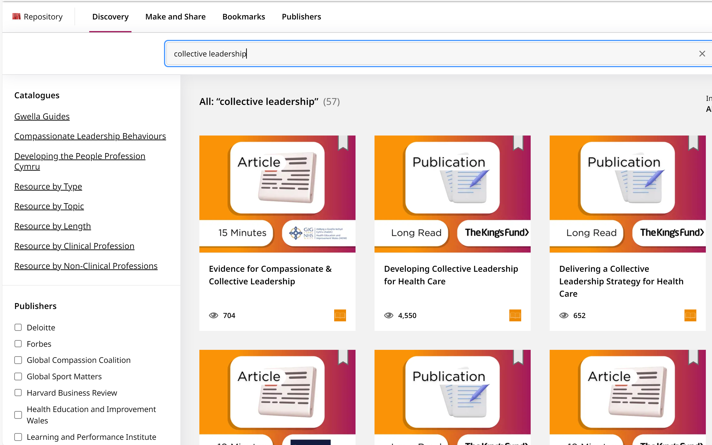

More resources…
Notes:
How to access other team resources
Show Gwella resource page - Gwella HEIW Leadership Portal for Wales
Enter Direction, Alignment and Control in search engine Search - Gwella HEIW Leadership Portal for Wales
Enter Compassionately Managing Conflict in search engine Repository - Gwella HEIW Leadership Portal for Wales
Enter Collective Leadership in search Engine Repository - Gwella HEIW Leadership Portal for Wales and scroll to ‘Developing Collective Leadership for Health Care’ – The King’s Fund
Other resources:
A range of resources available on Gwella on this page around equality, inclusion and diversity Principle: Improve Equality, Inclusion and Diversity, Consciously Removing Barriers and Boundaries - Gwella HEIW Leadership Portal for Wales
A range of resources available on Gwella on this page around Collective Leadership Principle: Create Environments Where Collective Leadership Thrives - Gwella HEIW Leadership Portal for Wales

Slide 31
What has struck a chord with you today?
What action will you take back in the workplace to embed effective leadership through DAC?
What actions will you take back to embed collective and inclusive leadership?
What further support do you require?
Reflections and Next Steps

