Slide 1



Shaping Culture and Leadership in NHS Wales​
Module 2 : Leading Compassionate Team
and Inter-Team Working
Developed with Professor Michael West

Slide 2

Module 2: Compassionate Team and Inter-team Working
Why team and inter-team working is vital in health and social care
The key principles for working effectively with other teams and organisations
The five elements of team psychological safety and the role of compassionate leadership in sustaining them
The national resources and tools available to enhance team working and establish compassionate and collective teams

Slide 3
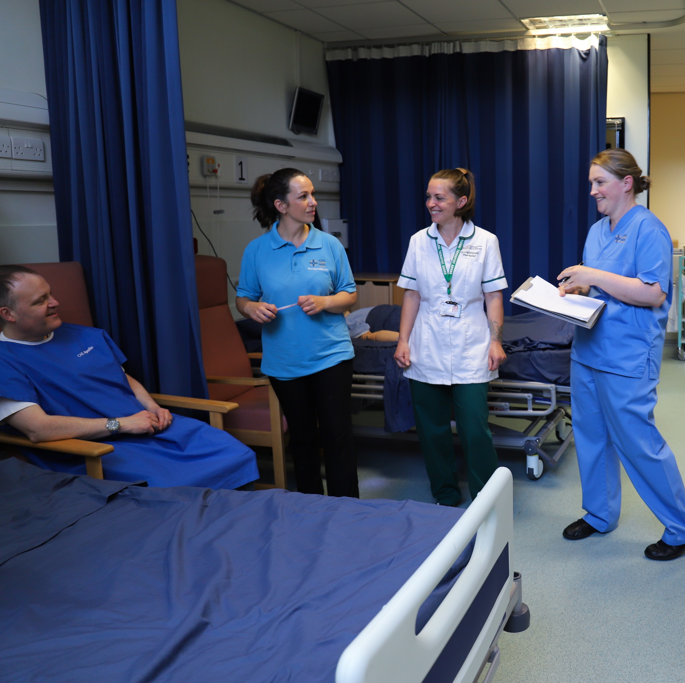

Exercise
“What are the benefits
of working in an
effective team?
1
Notes:
Exercise 1 - Individual / pairs (Exercise sheet 1)
Reflect on the most effective team you have worked in and the least effective team. What are the key characteristics of effective teams?
Share in small groups and summarise key themes for feedback in plenary noting / summarising key themes emerging

Slide 4

Why Teamworking?
A need for belonging
Support from colleagues enables people to thrive in their work
Exclusion, discriminations, bullying, incivility and chronic conflict have the opposite effect
Notes:
The need for belonging reflects our human desire to feel and be connected to others - to feel included, values, respected and supported in teams and organisations and to care and be cared for in those contexts.
There is abundant evidence to show that support from colleagues enables people to thieve in their work, helps them cope with difficult work experiences, and buffers them from the wider organisational factors that cause irritation and stress.
Exclusion, discriminations, bullying, incivility and chronic conflict have the opposite effect. The support of health and social care colleagues for each other in teams has been movingly evident during the pandemic enabling most to cope successfully in very challenging times

Slide 5
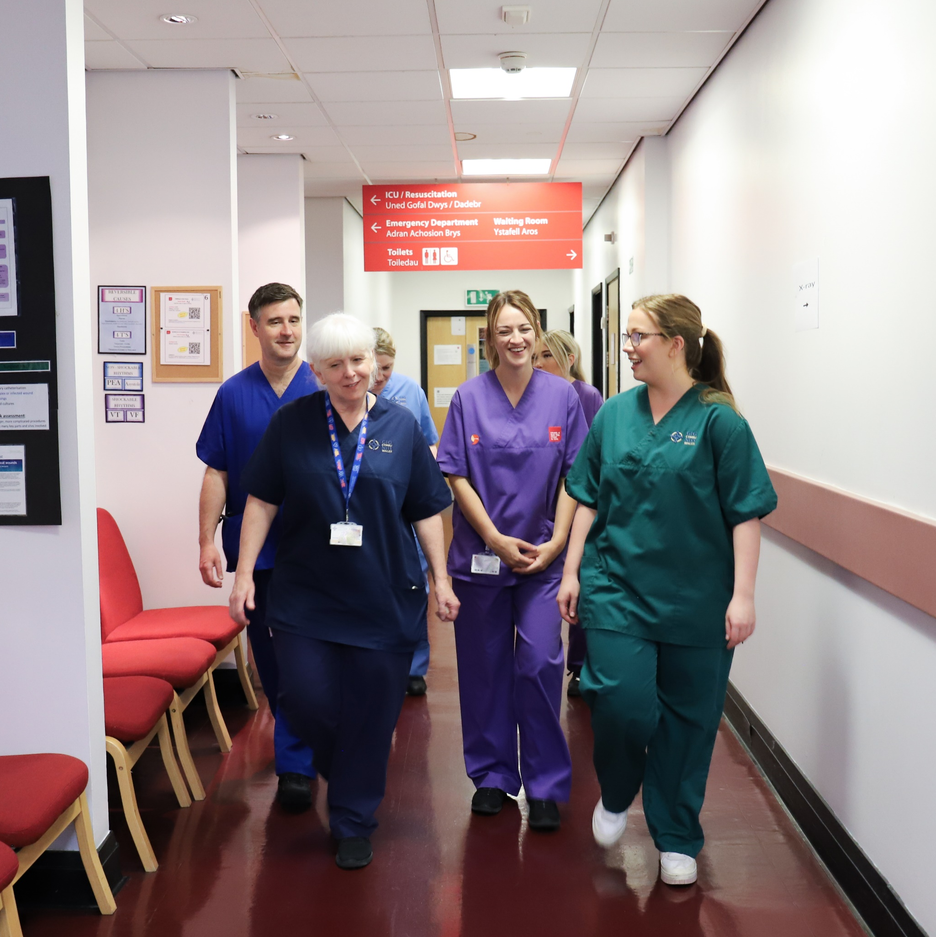
Teamwork positively impacts:
Staff health and wellbeing
Care quality
Financial performance
Innovation
Patient satisfaction
Reduced errors
Reduced intention not quit
Avoidable patient mortality
Notes:
Evidence
A review of the literature suggests that team working in healthcare is associated positively with a range of patient outcomes and echoes' previous review conclusions that that good team working reduced errors in patient care and improved quality (West M.A. & Anderson, (1996) Innovation in top management teams. Journal of applied psychology 81(6), 680-693)
A review of team working in intensive care settings concluded that working in teams can significantly reduce the level of errors and promote learning and quality improvement in intensive care units (West M.A. & Anderson, (1992) Innovation, cultural values and the management of change in British hospitals. Work and stress, 6(3), 293-310
There is evidence that poor team working leads to medical errors, while good team working prevents them. Researchers have found that medical errors were often a result of poor teamwork and status hierarchies with reluctance by lower level; team members to challenge the decisions of more senior team members (West M.A. & Coia, D.D. (2019) Caring for Doctors, Caring for Patients. London: General Medical Council

Slide 6
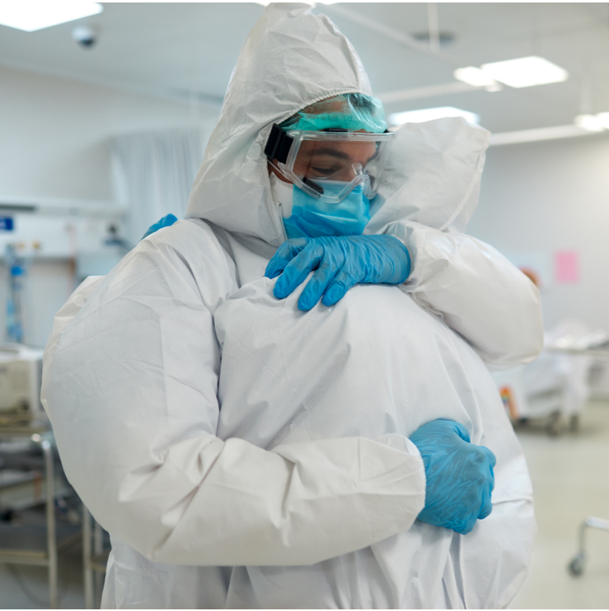
Teamworking
To enable health and social care staff to deliver high quality, compassionate care and to flourish, all must work together to create positive, supportive, compassionate and inclusive workplaces
M West (2021)
Notes:
Evidence
A review of the literature suggests that team working in healthcare is associated positively with a range of patient outcomes and echoes' previous review conclusions that that good team working reduced errors in patient care and improved quality (West M.A. & Anderson, (1996) Innovation in top management teams. Journal of applied psychology 81(6), 680-693)
A review of team working in intensive care settings concluded that working in teams can significantly reduce the level of errors and promote learning and quality improvement in intensive care units (West M.A. & Anderson, (1992) Innovation, cultural values and the management of change in British hospitals. Work and stress, 6(3), 293-310
There is evidence that poor team working leads to medical errors, while good team working prevents them. Researchers have found that medical errors were often a result of poor teamwork and status hierarchies with reluctance by lower level; team members to challenge the decisions of more senior team members (West M.A. & Coia, D.D. (2019) Caring for Doctors, Caring for Patients. London: General Medical Council

Slide 7

Effective Teams
40% of staff work in real teams
50-60% of staff work in pseudo teams
Effective teams are ‘real teams’
Shared leadership = valuing all contributions
Psychological safety = everyone feels included, cared for and valued
Notes:
What do we mean by effective teams?
The following slides explore this further, but as you can see from this data, only about 40% of NHS E staff working in the acute sector work in real teams. It will be really interesting to see how this compares to NHS Wales after the Staff survey in September 2023.
Across the UK, between 50-60% work in pseudo teams – that means teams wit no clear shared objectives, teams that do not meet regularly to review performance and improvements
Real and effective teams have climates of psychological safety, shared team leadership, take time to review and improve and work cooperatively across boundaries with other teams and departments. What is the climate of your team? We’ll explore later.
Shared leadership is prominent in real teams
Psychological safety ensures inclusion, care and value for team members

Slide 8
Features of ‘Real’ High Performing Teams
Dimension | Key questions
Clear team identity | Is everyone clear about the inspiring purpose and about who are the members of the team?
Clear, agreed team goals | Has the team agreed specific, measurable, challenging goals (4 or 5 max) aligned to the purpose?
Team member role clarity and supportive relationships | Are all team members clear about their roles? Are all relationships compassionate and supportive? Absence of chronic conflict?
Inclusion in decision making | Are all team members involved in decisions which affect the team’s work?
Effective team communication and decision-making | Are there regular, positive engaging team meetings? Is decision-making within and between teams regularly reviewed and improved?
Constructive debate, valuing diversity and improvement | Does the team review its effectiveness and have constructive, mutually respectful discussions to improve quality? Is diversity in all forms positively valued? Is the team innovating continually? Time and space for reflection?
Effective inter-team working | Are team members committed to improving working relationships with other teams and are these regularly reviewed and improved?
2
Notes:
Exercise 2 – Real high performing teams (Exercise sheet 2)
Individually, ask participants to review the dimensions of real high performing teams then apply the questions to their own team rating 1 to 5 (5 being high)​.
Ask participants to identify one thing they could do to help meet one of the dimensions
Discuss findings.

Slide 9

Effective Teams Should:
Usually have no more than 8-10 people
Have 5-6 clear shared goals
Have data or information that ensures helpful feedback in relation to their progress in achieving their goals and objectives
Have team member clear about their roles in the team
Have a team climate characterised by positive emotions and a sense of psychological safety
Notes:
Teams with these characteristics ensure greater role clarity for team members, provide high levels of social support, and buffer members form the negative and depleting effects of wider organisational demands.
Good team leadership also ensures connection and compassion across boundaries so that healthcare staff work together across professions to deliver high quality care
Where there are larger numbers of team members(as is typical on wards and in general practice), it becomes more difficult to manage team processes and communication, and so clear protocols and the concept of ‘teams within teams’ are required
In modern health and care services, the skills of ‘Teaming’ enable people to work in multiple teams with a variety of team members who may be different across shifts are vita. But is is also necessary for wellbeing and effectiveness to have stable membership of a home team. Dropping in and out of teams or rarely being part of a team with the same team members, undermines the sense of connection, community and belonging.

Slide 10

All Health and Social Care Staff should belong to a (where possible multidisciplinary) ‘home team’
that enables:
Involvement in quality improvement initiatives
A sense of belonging and social support
A space to discuss challenges, difficulties and frustrations
Opportunity for appreciation and recognition
Clarification of roles and responsibilities
Peer coaching and mentoring
Professional development
Leadership Development and teamwork training
Notes:
Open Question – how many of you work across different teams where the members of that team change depending on shifts etc? How does it feel? Are there any disadvantages? What would they be?
In modern health and care services, the skills of ‘teaming’ that enable people to work in multiple teams or with a variety of team members who may be different across shifts are vital. – but it is also necessary for wellbeing and effectiveness to have stable membership of a home team. Dropping in and out of teams or rarely being part of a team with the same team members, undermines the sense of connection, community and belonging
Belonging to a home team enables:
Involvement in quality improvement initiatives
A sense of belonging and social support
A space to discuss challenges, difficulties and frustrations
Opportunity for appreciation and recognition
Clarification of roles and responsibilities
Peer coaching and mentoring
Professional development
Leadership Development and teamwork training

Slide 11
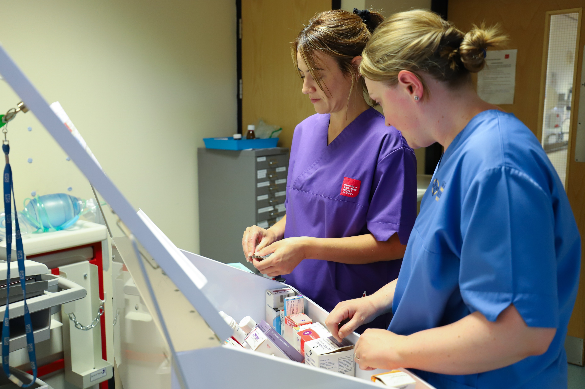
5 principles for working effectively with other teams and organisations:
Shared vision
Shared long-term goals
Frequent positive contact
Constructive controversy
Mutual support
Notes:
Working un teams is vital for health and social care quality but there is also good evidence that those working in supportive ‘real teams’ with good team leadership, have significantly lower levels of stress than dysfunctional or ‘pseudo’ team in health and social care
The more people working in ‘real teams; in a healthcare organisation, the lower levels of stress, errors, injury, harassment, bullying and violence against staff, staff absenteeism, (in the acute sector) patient mortality, and higher levels of patient satisfaction.
The quality of teamworking and inter-team working in the UK is often poor. The basic mechanisms of effective team working are often not in place in our organisations, even through there is extensive international research that consistently identifies what is required to have effective teams in health and social care
Successive enquiries into failings in healthcare nationally and internationally identify culture and teams work as fundamental to success

Slide 12
Compassionate Teams – How Is Your Climate
Does your team focus on effectiveness by clarifying the vision and direction of their work, aligning their efforts around that vision and developing high levels of trust and motivation?
Is your team inclusive, valuing all team members equally in relation to knowledge, skills and experience; professional background; ethnicity, sexuality, gender identity, age; opinions and perspectives?
Does your team model shared team leadership and everyone having authority and influence?
Is your team focused on collaborating and supporting across boundaries with other teams and sectors ensuring a commitment to providing high quality health and social care, not simply their own areas of responsibility?
3
Notes:
Exercise 3
Individual exercise - - participants to read the 4 statements form slide (or exercise sheet) and rate their team out of 5 (5 being good)
Ask for one thing that could be done to improve their team climate.
Discuss in plenary and explore ideas

Slide 13

Exercise
What are the 5 elements that nurture psychological safety?
4
Notes:
Exercise 4 – Psychological safety
In groups or pairs, discuss what you think are the elements that nurture psychological safety in teams? Provide the exercise sheet for participants to record their thoughts.

Slide 14


The key elements that nurture psychological safety
Shared Vision Values and Objectives
Compassionate Leadership
TRUST
Reflexivity, Innovation and Learning
Frequent, Positive Contact
Valuing Diversity, Difference and Positive Conflict
Effective Team-Working
INNOVATION
Mutual Support Compassion and Humility
Notes:
Shared vision, values and objectives – compassionate leadership is focused on ensuring a clear shared vision of working to provide high-quality care and support to those we serve. When a team has a clear shared vision of its purpose, team members are united around an inspiring direction for their work. Clear, shared values is also helpful to ensure that team members have agreed how they should work together, by committing for example, to mutual respect, to valuing all members contributions and to compassion, honesty and support. A way of achieving this agreement is to ask teams to agree on ‘five things we must always do and 5 things we must never do. Equally important to sense of purpose is translating the vision into a limited number of clear, agreed and challenging goals or objectives – no more than 4-6 challenging goals or objectives aligned to the vision of the team and agreed by team members not imposed.
Reflexivity, learning and innovation – compassionate leadership will help create psychologically safe teams by encouraging members to:
Share learning, including about errors and near misses
Avoid unnecessary blaming
Improve the quality of their work through regular reviews of working methods
Develop and implement ideas to improve quality
Support others in implementing ideas for new and improved ways of working
To sustain psychological safety in teams, team members must be compassionate in their interactions with each other and they must commit to:
Paying attention to each other (listening with fascination
Developing mutual understanding
Being empathetic and caring
Practically supporting each other
In safe environments there are higher levels of learning and innovation – Blaming cultures in contrast are fearful, inhibit compassion and prevent learning
Frequent, positive contact – compassionate leadership in teams involves being present with those we lead and helping them be present with each other. Team members feel safer with each other when they meet, interact, chart, share coffee or lunch together and simply engage. Face to face is the richest form of human contact.
Valuing diversity, difference and positive conflict – If leadership in teams is not inclusive, it is not compassionate. Teams composed of people with differing professional and demographic backgrounds and diverse knowledge, skills, experience and abilities are more likely to develop and implement quality improvements or new ways of doing things. This is because they bring usefully differing perspectives on the issues to the group. But generally high diversity leads to team innovation only when the team feels psychologically safe.
Chronic interpersonal conflict is almost always destructive and prevents teams from delivering high-quality compassionate care. Chronic interpersonal conflicts must therefore be compassionately confronted and prevented within teams, and this is a responsibility of all team members.
Mutual support, compassion and humility – the need for belonging reflects our desire to feel and be connected to others – to feel valued, respected and supported in teams and organisations and to care and be cared for in these contexts. It is met by working in nurturing teams and in cultures and climates that reinforce the sense of relatedness. Health and care jobs are stressful occupations for obvious reasons. What helps people manage that stress is the support, camaraderie, god humour and compassion of colleagues. The support of colleagues buffer people from the stresses they experience at work, helping them to be clear about their work roles, helping them to cope with difficult working experiences and buffering them from the wider organisational factors that cause irritation and stress

Slide 15
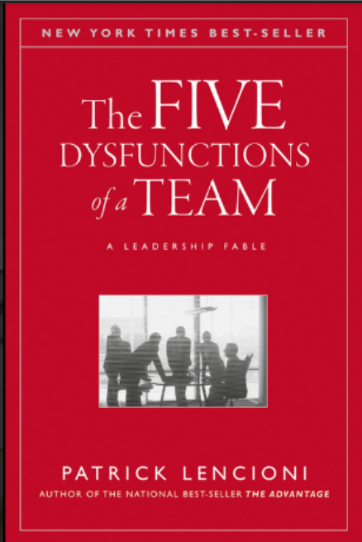
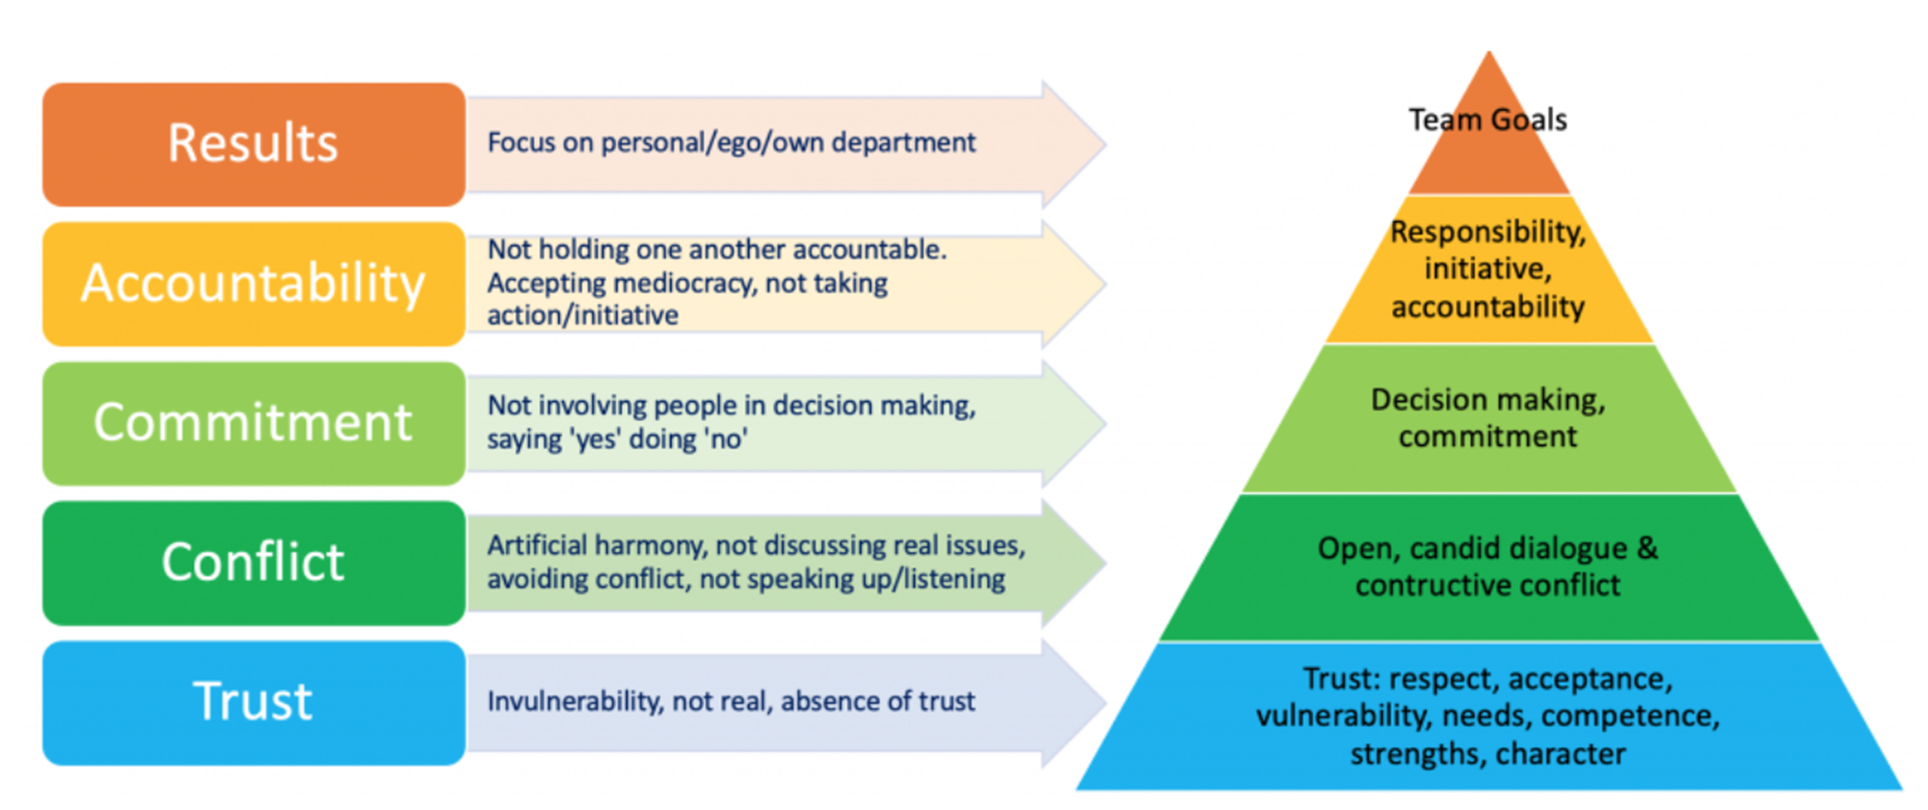

The Five Dysfunctions of Team
Notes:
Taken from the Five dysfunctions of a team - Patrick Lencioni
Trust: At the bottom of the pyramid is the absence of trust, when team members feel they cannot show their weaknesses, resulting in a reluctance to be vulnerable. Members of the team will be reluctant to admit their mistakes and ask for help.
Conflict: Lack of trust causes team members to be afraid of conflict, which prevents them from engaging in debates or voicing their opinions openly. In order to achieve superior results, the team completely avoids conflicts.
Commitment: Conflict fear leads to a lack of commitment. In an environment of ambiguity, team members don't feel committed to the same as they haven't bought into the decisions.
Accountability: When team members lack commitment, they do not hold one another accountable. People won't hold their peers too accountable if they don't believe in the decision.
Results: Team members will put their own interests (ego, recognition, career development, etc.) ahead of the team's goals if they don't feel accountable. As a result, the team loses sight of itself and the company suffers.

Slide 16
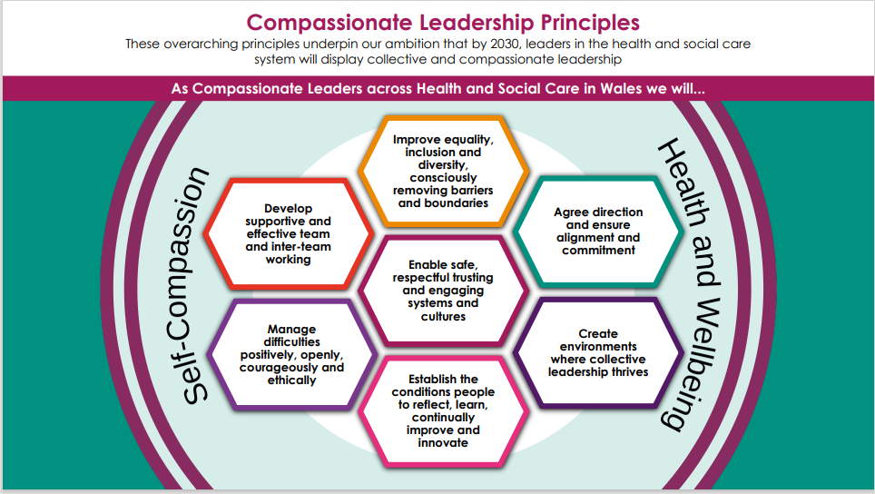

Slide 17

Exercise
How will you embed one or more of the Compassionate Leadership Principles within your team?
5
Notes:
Exercise 5
Individual work - Ask participants to record on the exercise sheet how they can embed or support the embedding of one of more principles in their team.
Explore responses in plenary.

Slide 18
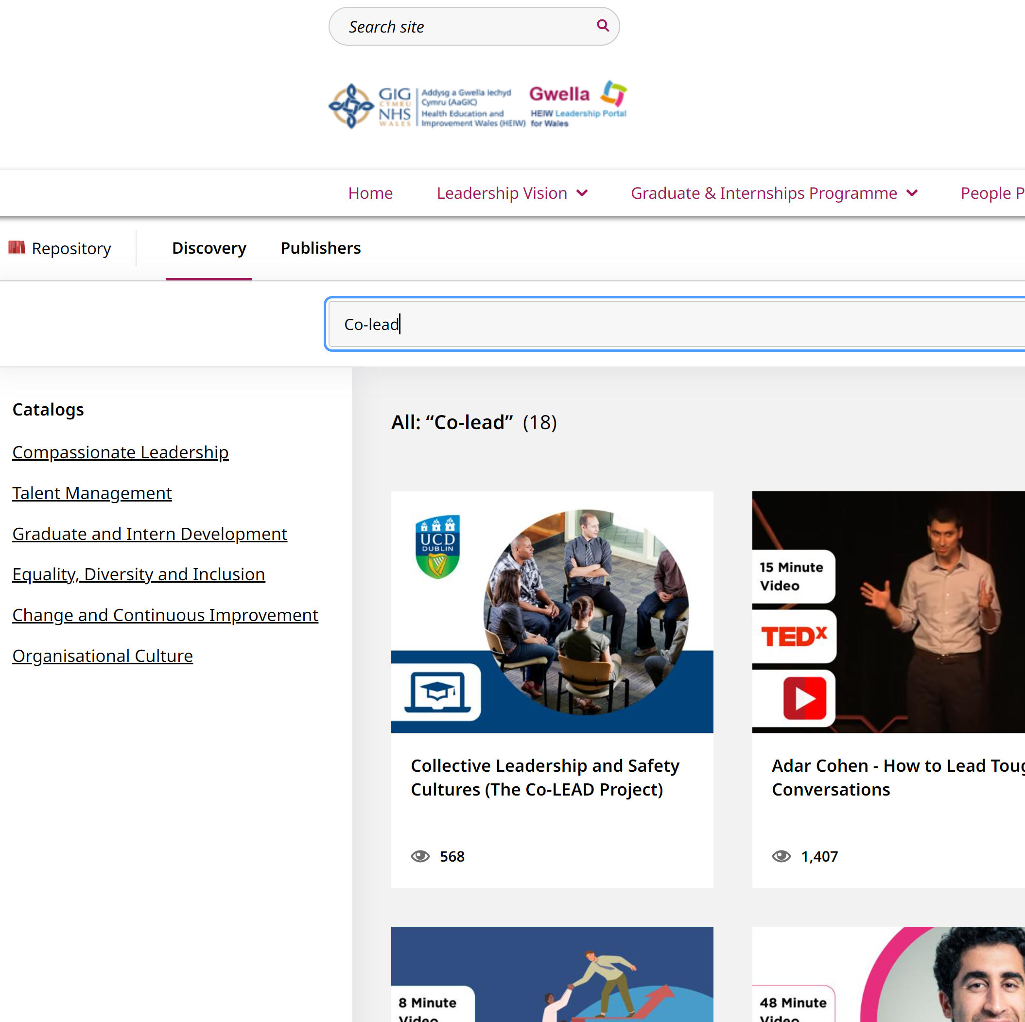

More resources…
Notes:
How to access other team resources
Show Gwella resource page - Gwella HEIW Leadership Portal for Wales
Enter co-lead in search engine Search - Gwella HEIW Leadership Portal for Wales
Bring up co-lead and launch Repository - Gwella HEIW Leadership Portal for Wales
Scroll down on co-lead to access more team resources
Other resources:
Supportive and effective Team work – Mark Rhodes Repository - Gwella HEIW Leadership Portal for Wales
Teamworking, Psychological Safety and Compassionate Leadership (Blog, Prof. M.A.West) Repository - Gwella HEIW Leadership Portal for Wales
Leading high performance teams to achieve alignment behind a vision – Wendy Derrick Expert Leadership Series: Leading High Performance Teams to Achieve Alignment Behind a Vision - Gwella HEIW Leadership Portal for Wales
Having your first ‘difficult; conversation – The institute of Leadership and Management Repository - Gwella HEIW Leadership Portal for Wales
How to be fearless – the high performance podcast – Dr Pippa Grange Repository - Gwella HEIW Leadership Portal for Wales
Compassion can produce better performance – just looki at the Lionesses – Cath Bishop Guradian article https://www.theguardian.com/sport/2023/aug/14/compassion-better-performance-lionesses-england-sarina-wiegman?CMP=share_btn_link

Slide 19
Reflections and Next Steps
What has struck a chord with you today?
What action will you take back in the workplace to become an effective team?
What further support do you require?

